Slide 1


R. GLENN
HUBBARD
ANTHONY PATRICK
O’BRIEN
FIFTH EDITION
© 2015 Pearson Education, Inc.

Slide 2
Macroeconomics in an Open Economy

Slide 3
Linkages between countries
Until now, we have mostly ignored the linkages among countries at the macroeconomic level.
But countries are linked:
By trade in goods and services
By flows of financial investment
In this chapter, we will consider how these linkages work, and what the implications are for fiscal and monetary policy.

Slide 4
The Balance of Payments:
Linking the United States to the International Economy
29.1
Explain how the balance of payments is calculated.

Slide 5
Open economies
Today it is routine for consumers, firms, and investors to interact with their counterparts in foreign countries.
A country that has interactions in trade or finance with other countries is known as an open economy, as opposed to a closed economy, which has no interactions in trade or finance with other countries.
No economy is completely closed; though a few countries, such as North Korea, have limited foreign economic interactions.

Slide 6
U.S. balance of payments, 2012
A good way to understand economic interactions with other countries is by examining the balance of payments (BoP): the record of a country’s trade with other countries in goods, services, and assets.
It is composed of the current account: the record of the country’s net exports,
net income on investments,
and net transfers…
CURRENT ACCOUNT
Exports of goods | $1,561
Imports of goods | −2,303
Balance of trade |  |  | −742
Exports of services | 649
Imports of services | −443
Balance of services |  |  | 207
Income received on investments |  | 776
Income payments on investments |  | −552
Net income on investments |  |  | 224
Net transfers |  |  | −130
Balance on current account |  |  | −440
FINANCIAL ACCOUNT
Increase in foreign holdings of assets in the United States | 544
Increase in U.S. holdings of assets in foreign countries | −105
Balance on financial account |  | 439
BALANCE ON CAPITAL ACCOUNT |  |  | 7
Statistical discrepancy |  | -6
Balance of payments |  | 0
Table 18.1
The balance of payments, 2012 (billions of dollars)

Slide 7
U.S. balance of payments, 2012—continued
… the financial account, which records
purchases of assets a country has made abroad,
and foreign purchases of assets in the country…
… and the capital account, which records relatively minor transactions such as migrants’ transfers and sales, and purchases of non-produced, nonfinancial assets.
CURRENT ACCOUNT
Exports of goods | $1,561
Imports of goods | −2,303
Balance of trade |  |  | −742
Exports of services | 649
Imports of services | −443
Balance of services |  |  | 207
Income received on investments |  | 776
Income payments on investments |  | −552
Net income on investments |  |  | 224
Net transfers |  |  | −130
Balance on current account |  |  | −440
FINANCIAL ACCOUNT
Increase in foreign holdings of assets in the United States | 544
Increase in U.S. holdings of assets in foreign countries | −105
Balance on financial account |  | 439
BALANCE ON CAPITAL ACCOUNT |  |  | 7
Statistical discrepancy |  | -6
Balance of payments |  | 0
Table 18.1
The balance of payments, 2012 (billions of dollars)

Slide 8
U.S. balance of payments, 2012—continued
The balance of payments is the sum of these three accounts.
It must equal zero. In 2010, the U.S. spent $440 billion more on goods, services, and other current account items than it received.
This money must have been used either to buy U.S. assets, or to keep as U.S. currency holdings overseas.
Statistical discrepancy is the difference.
CURRENT ACCOUNT
Exports of goods | $1,561
Imports of goods | −2,303
Balance of trade |  |  | −742
Exports of services | 649
Imports of services | −443
Balance of services |  |  | 207
Income received on investments |  | 776
Income payments on investments |  | −552
Net income on investments |  |  | 224
Net transfers |  |  | −130
Balance on current account |  |  | −440
FINANCIAL ACCOUNT
Increase in foreign holdings of assets in the United States | 544
Increase in U.S. holdings of assets in foreign countries | −105
Balance on financial account |  | 439
BALANCE ON CAPITAL ACCOUNT |  |  | 7
Statistical discrepancy |  | -6
Balance of payments |  | 0
Table 18.1
The balance of payments, 2012 (billions of dollars)

Slide 9







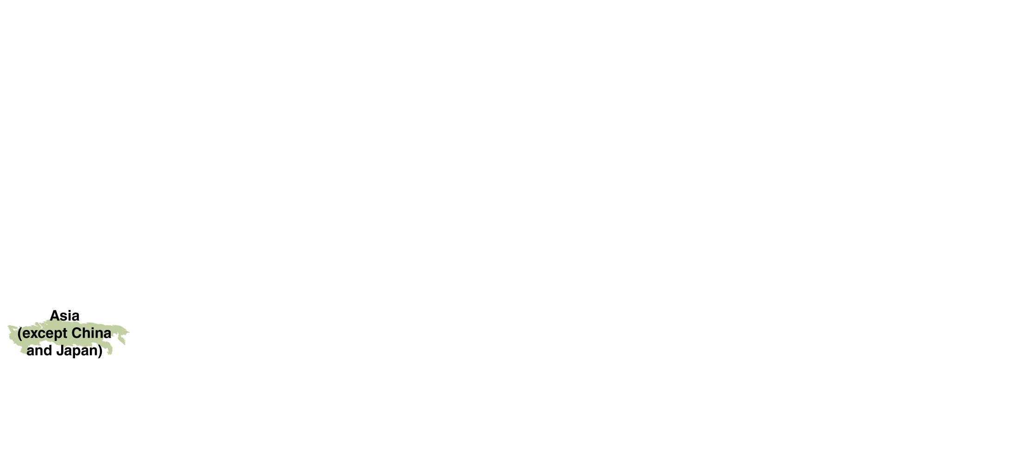


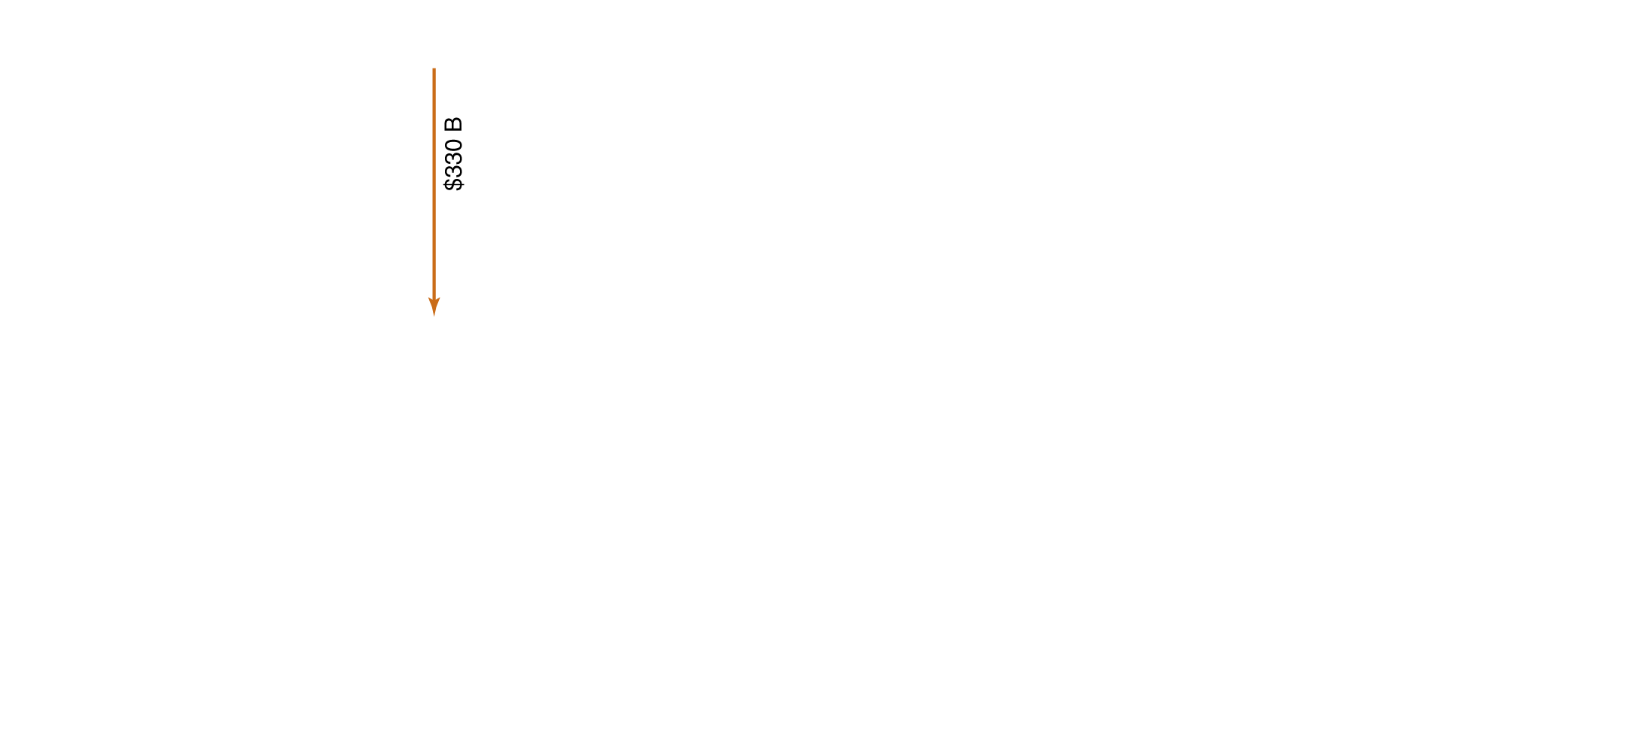
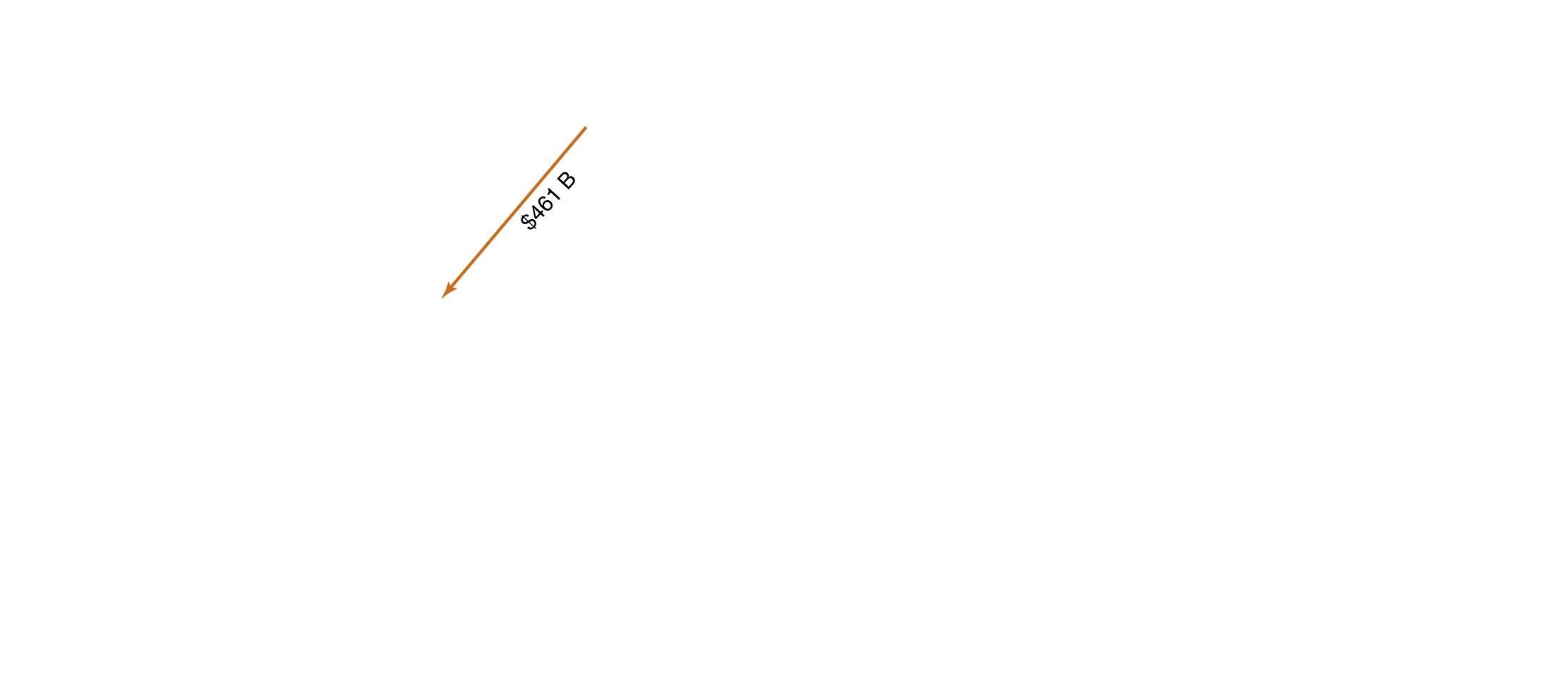
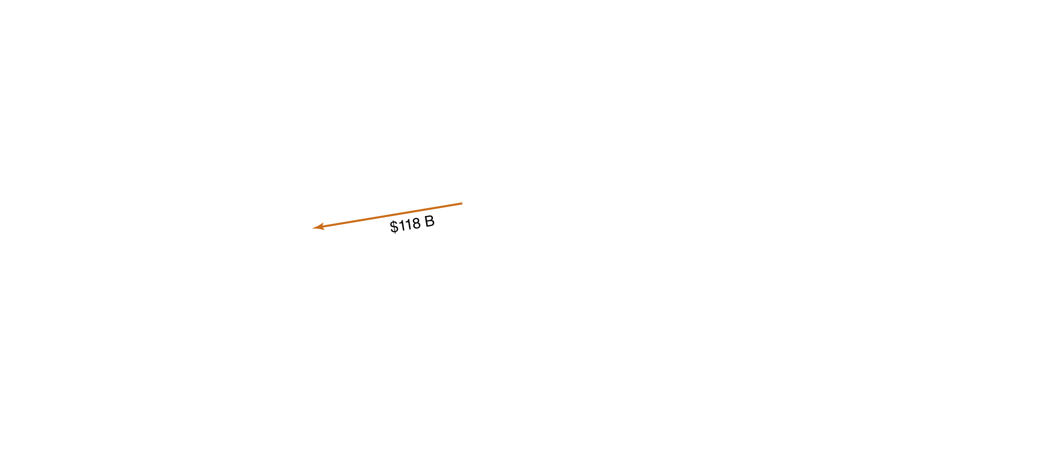
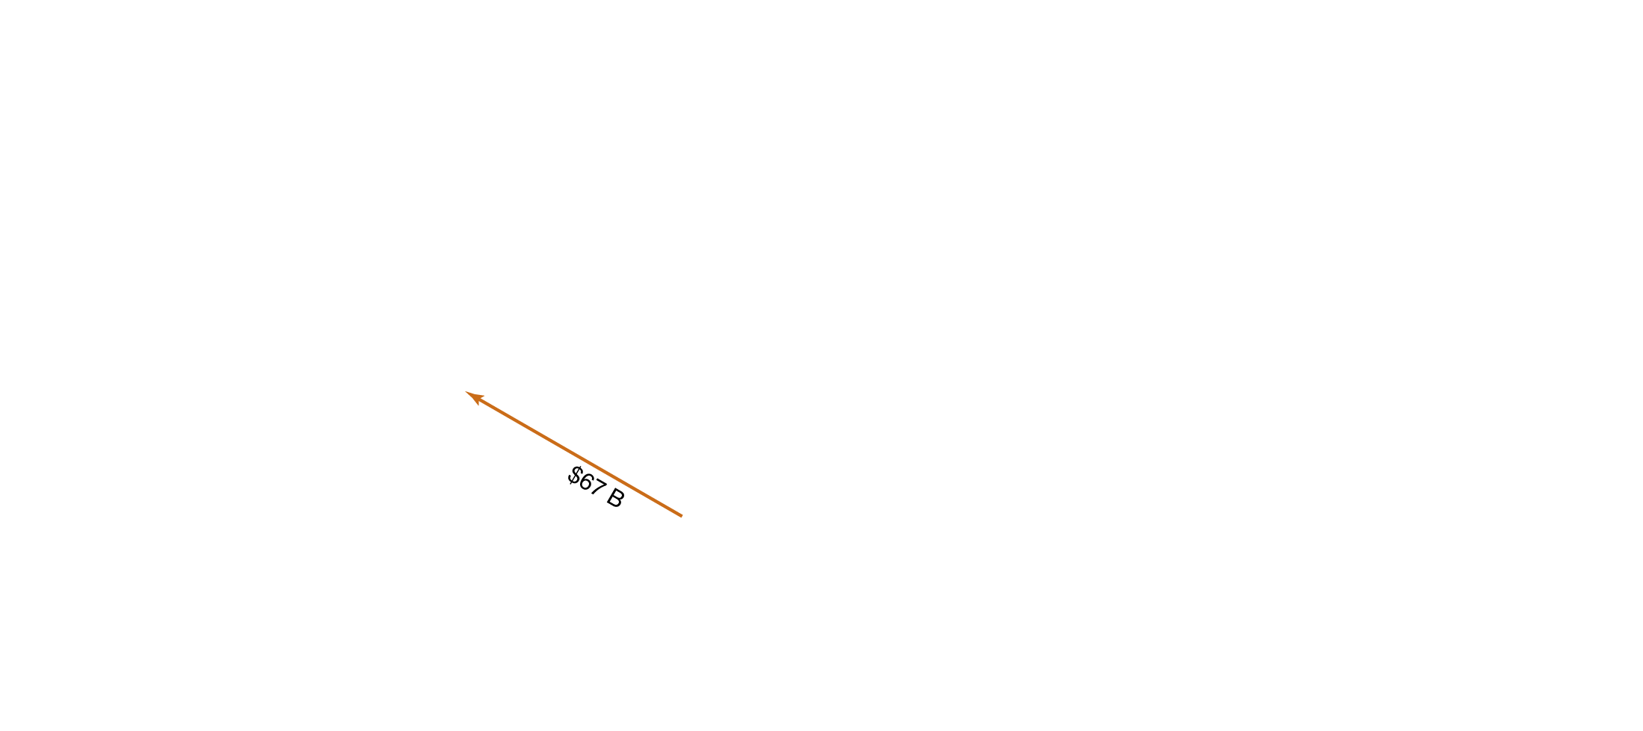
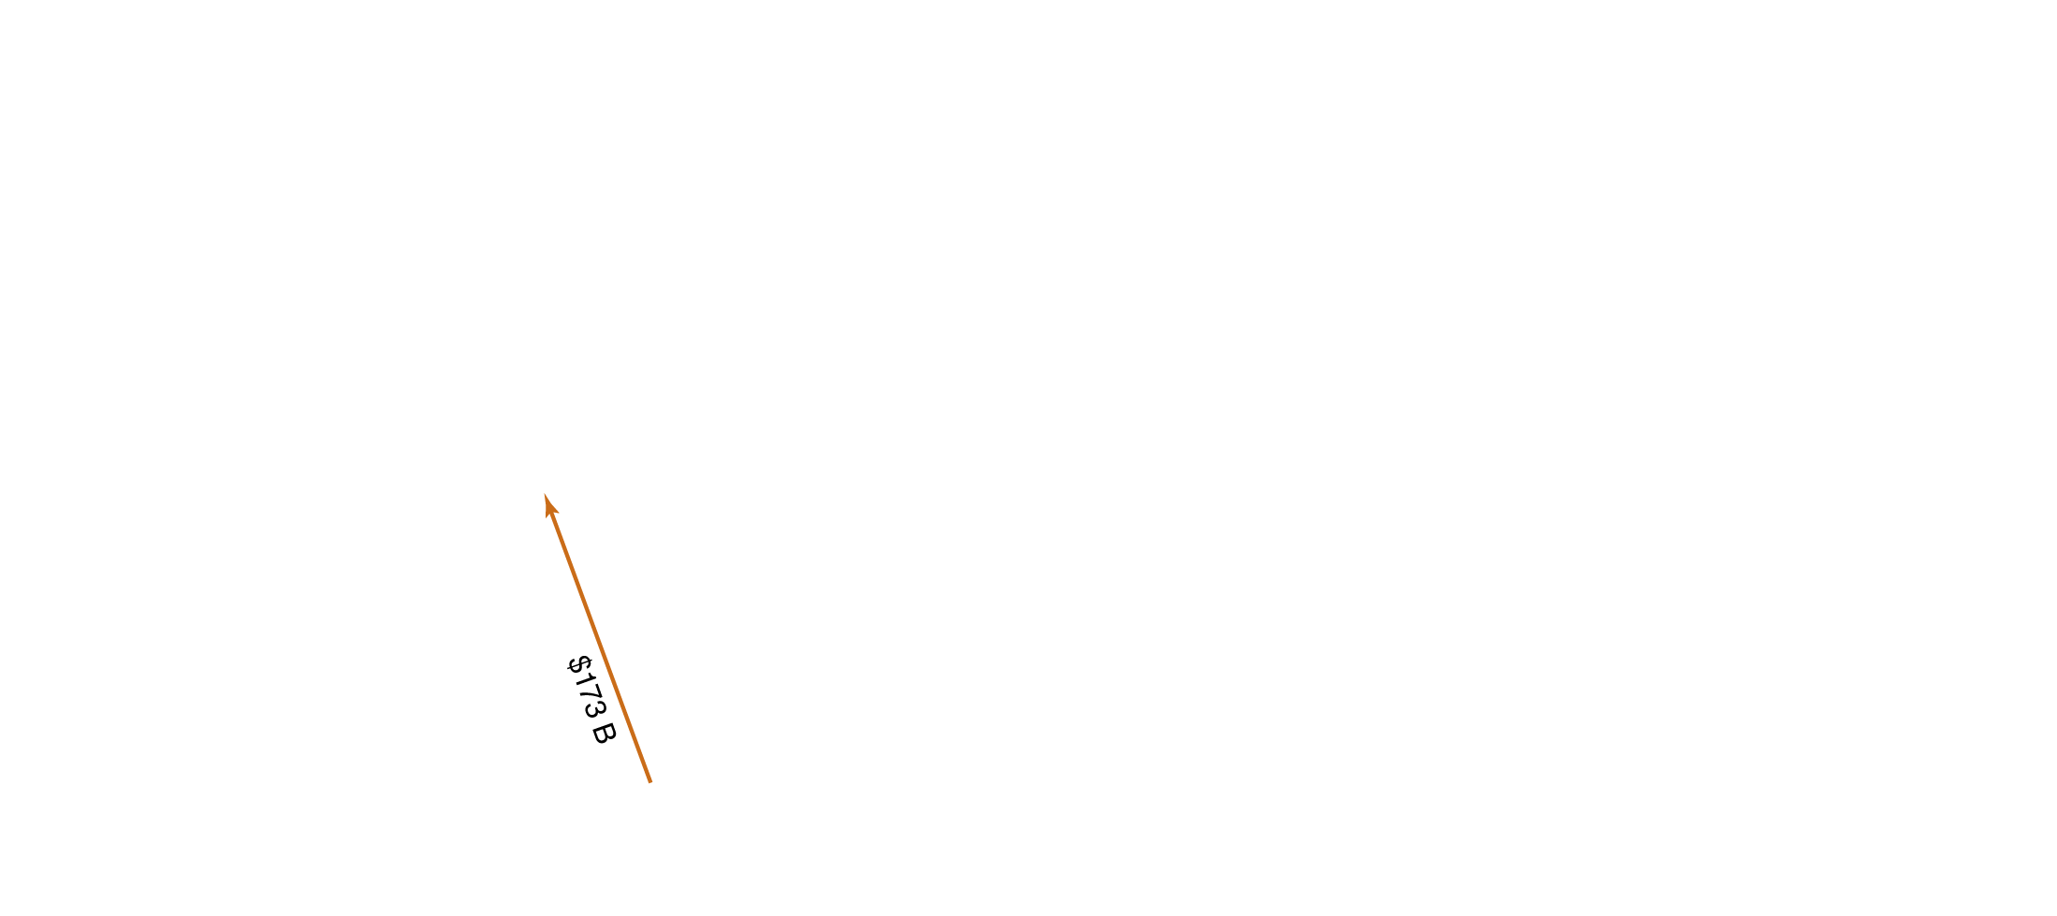
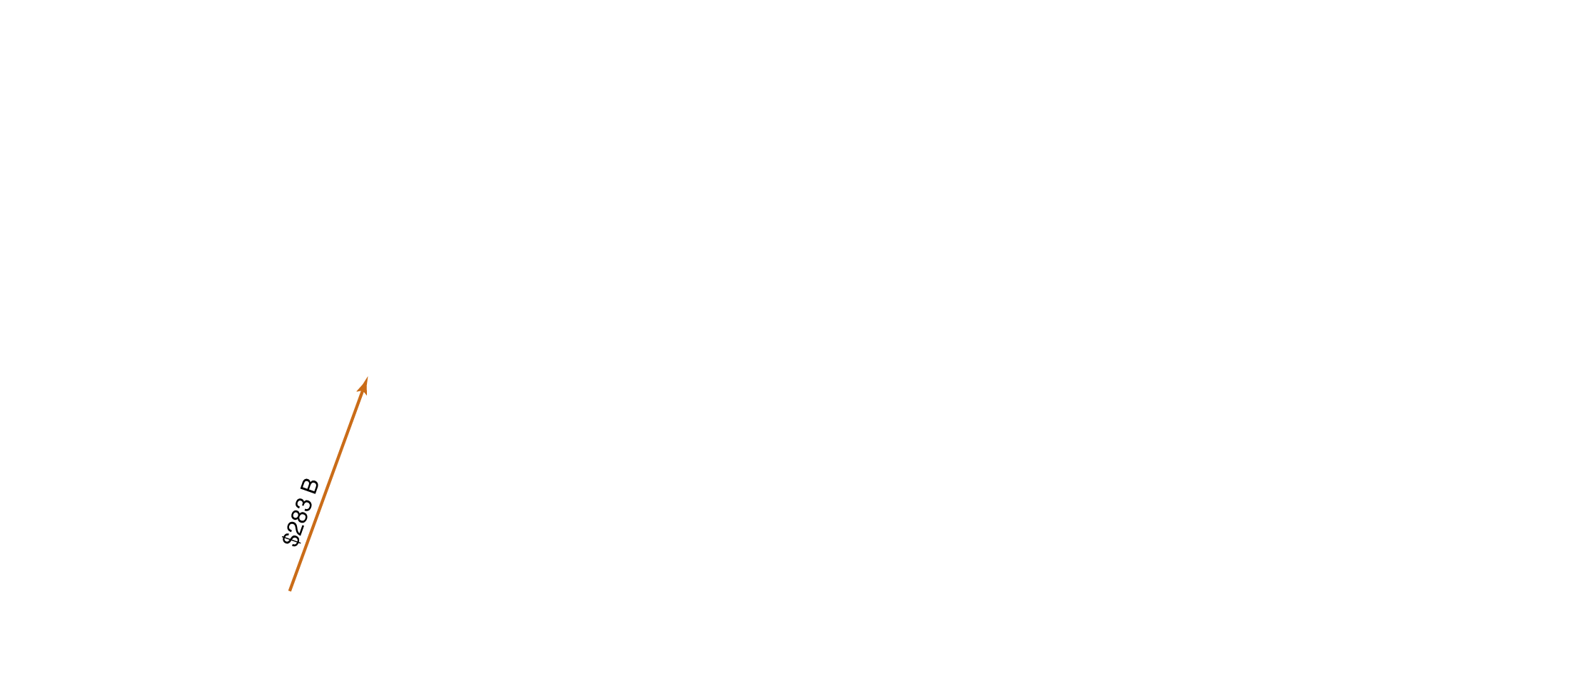
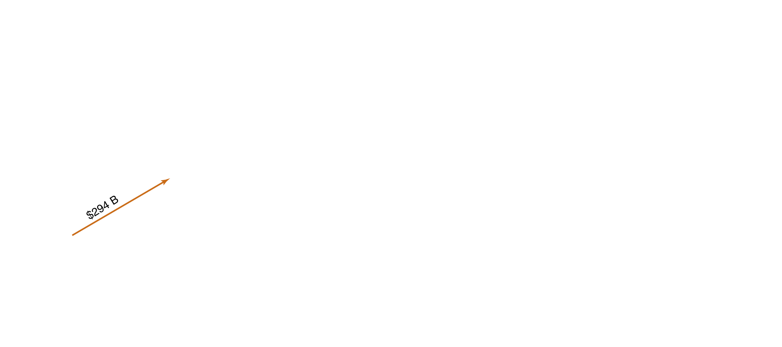
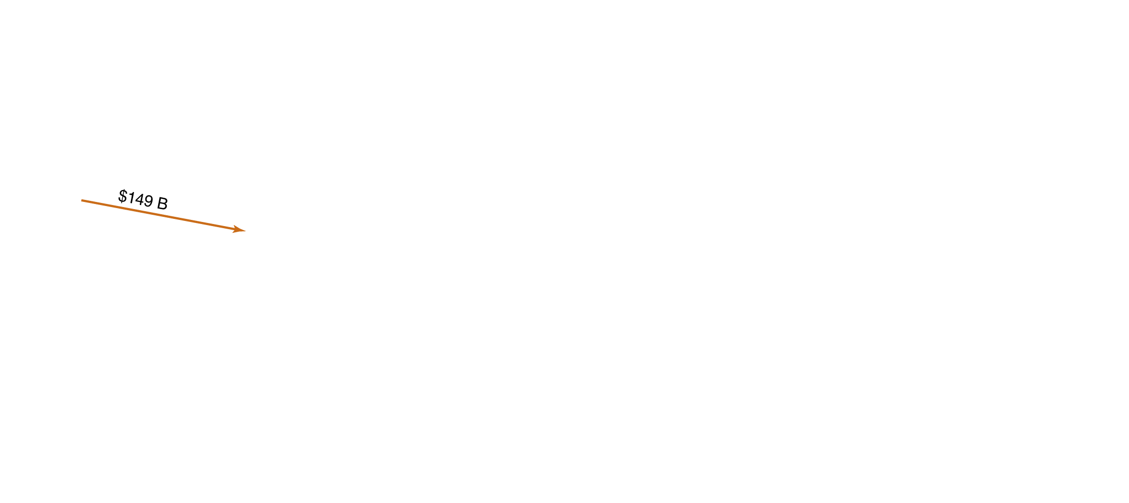
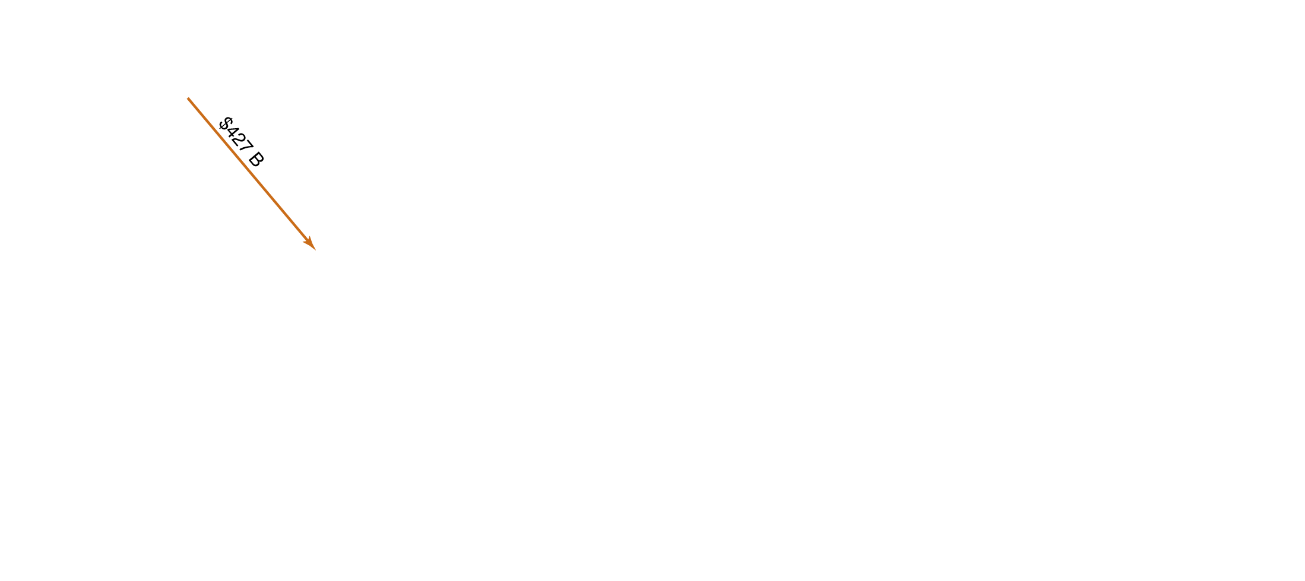
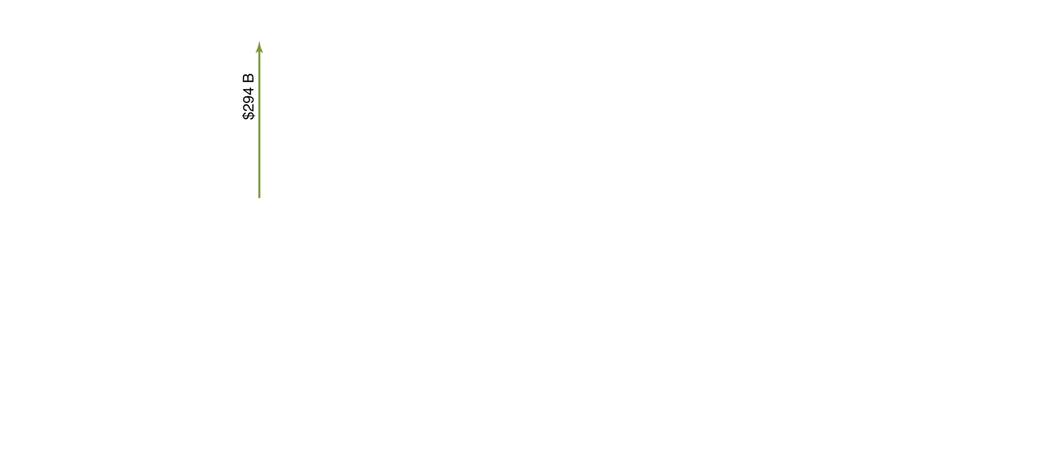
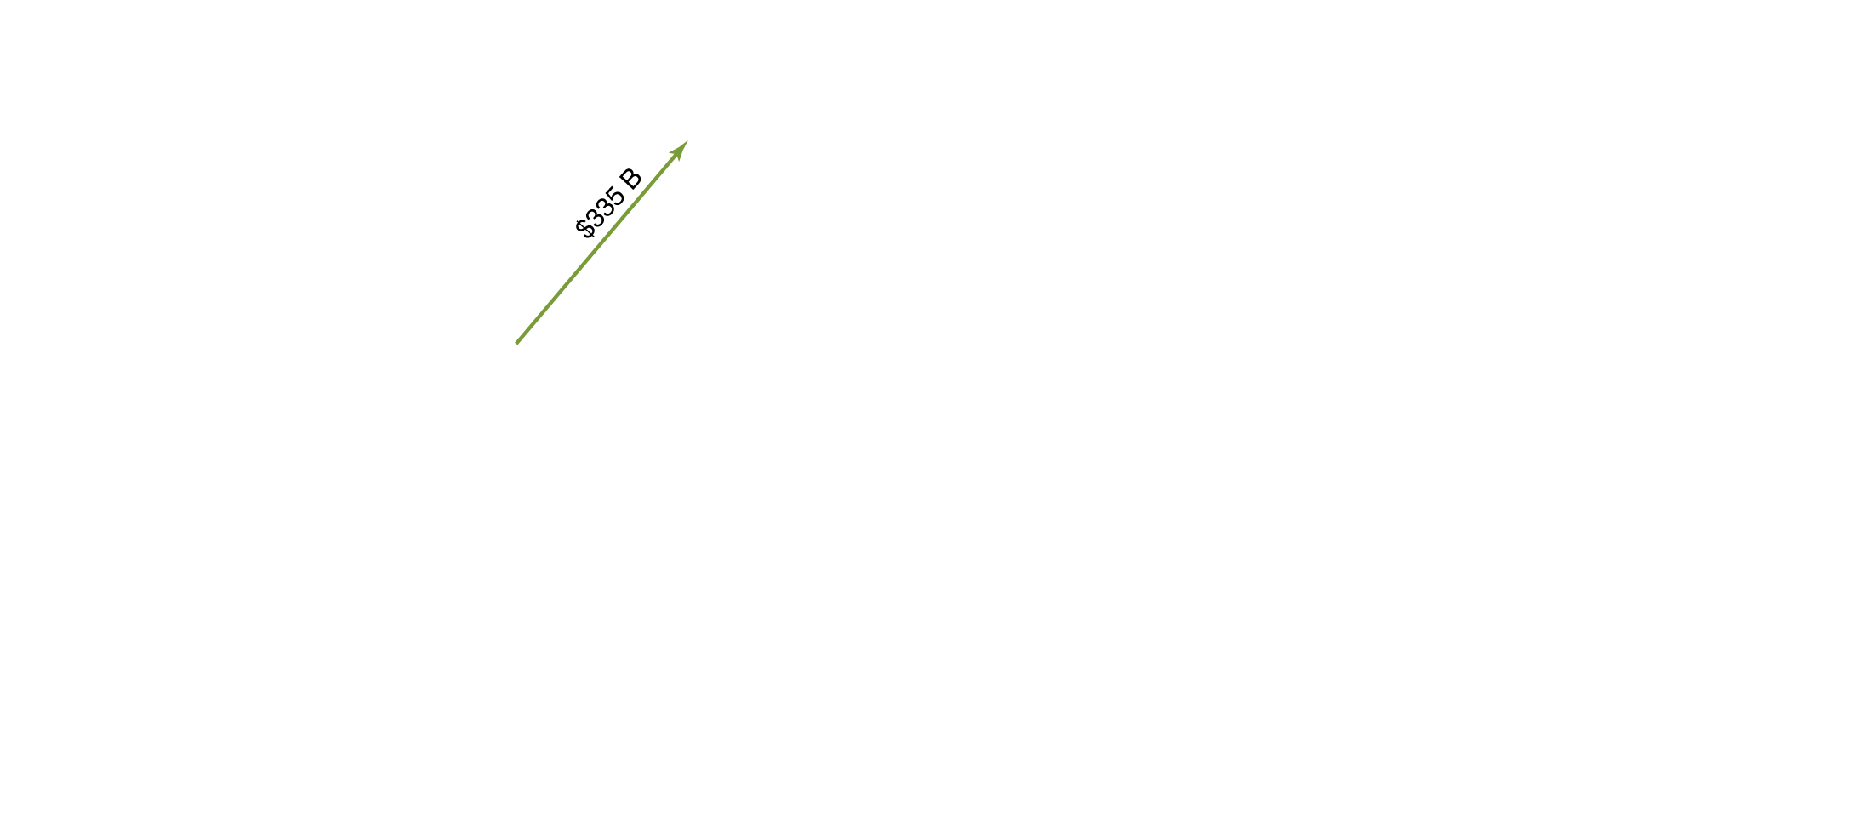
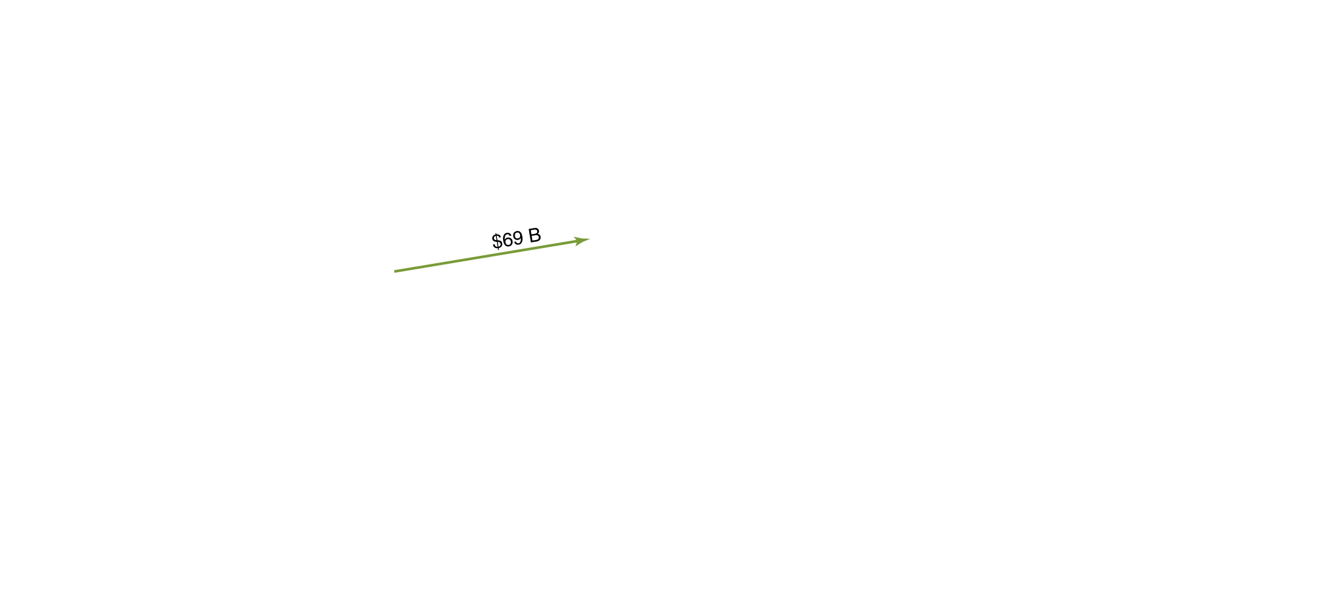
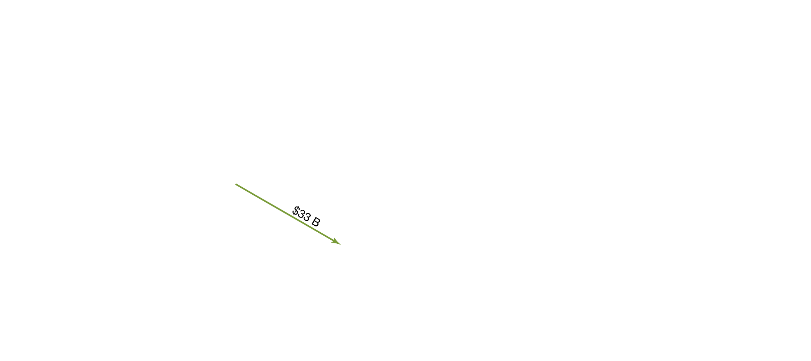
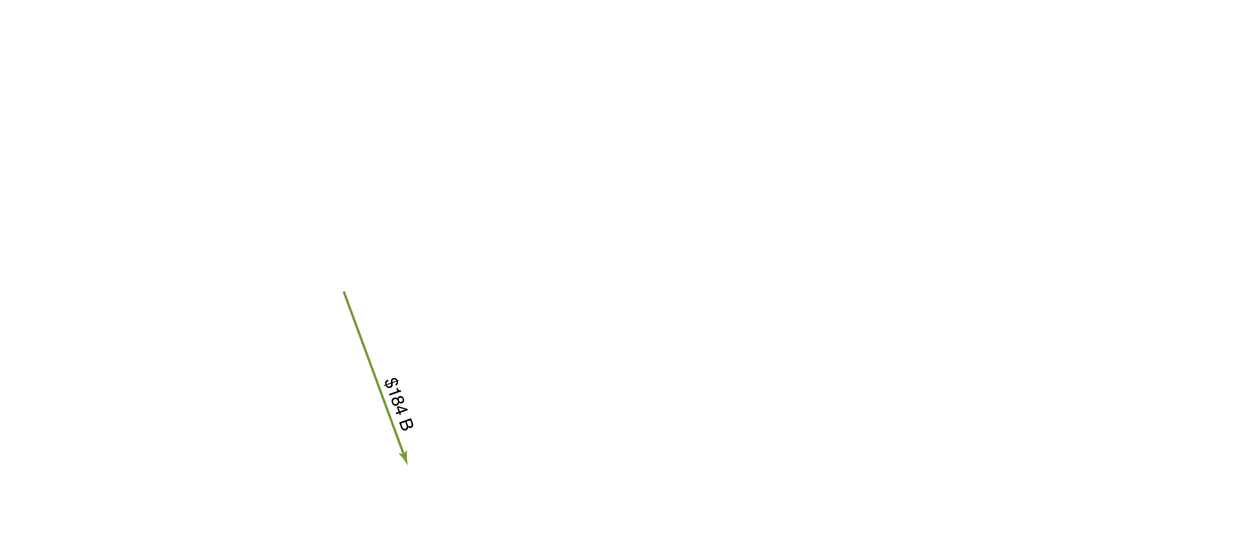

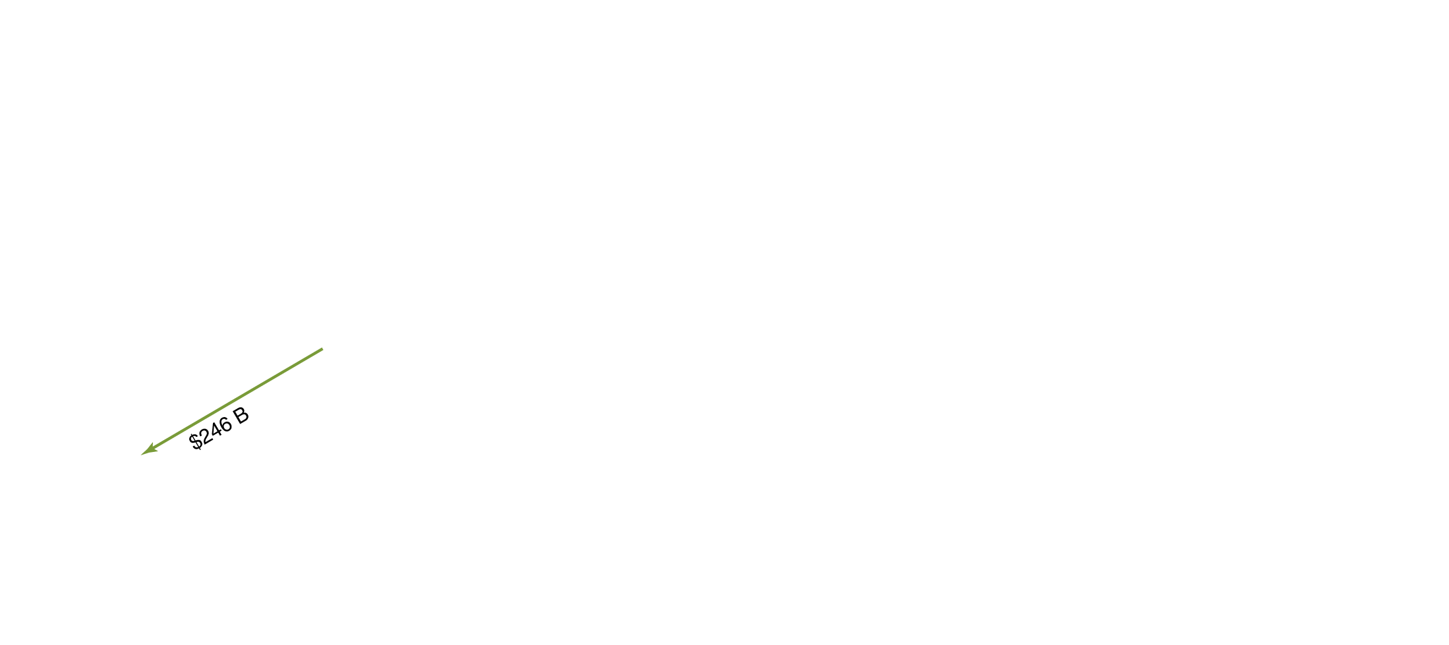
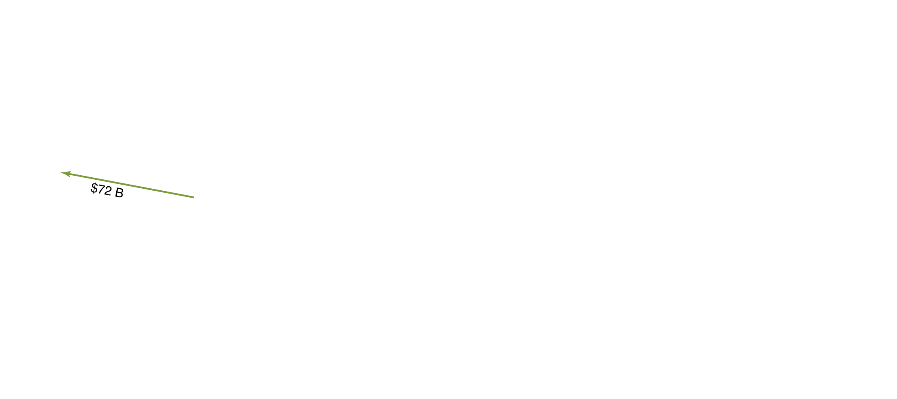
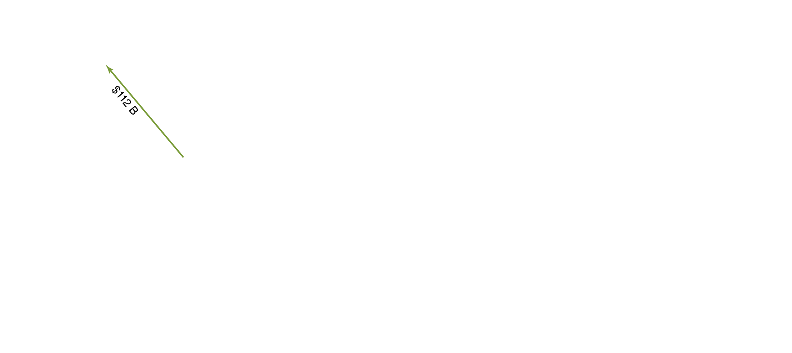
The current account and the balance of trade
The current account records a country’s net exports, net income on investments, and net transfers.
An important part of this is the balance of trade, the difference between the value of the goods a country exports and the value of the goods a country imports.
If this is positive, it is referred to as a trade surplus; a negative balance of trade is a trade deficit.
In 2012, the U.S. had a trade deficit of $742 billion; it had a trade deficit with every world region except Latin America excluding Mexico.
Figure 18.1a
Trade flows for the United States and Japan, 2012
Notes:
Panel (a) shows that in 2012, the United States ran a trade deficit with all its major
trading partners and with every region of the world except for Latin America.
Panel (b) shows that Japan ran trade deficits with China, Latin America, Europe,
Africa, and the Middle East, and ran trade surpluses with the United States and
Asia. In each panel, the green arrows represent exports from the United States or
Japan, and the red arrows represent imports.
Note: Japanese data are converted from yen to dollars at the average 2012 exchange
rate of 79.8 yen per dollar.
Sources: U.S. Bureau of Economic Analysis, “U.S. International Transactions,” June 14,
2013; and Japanese Ministry of Finance, Trade Statistics of Japan.

Slide 10









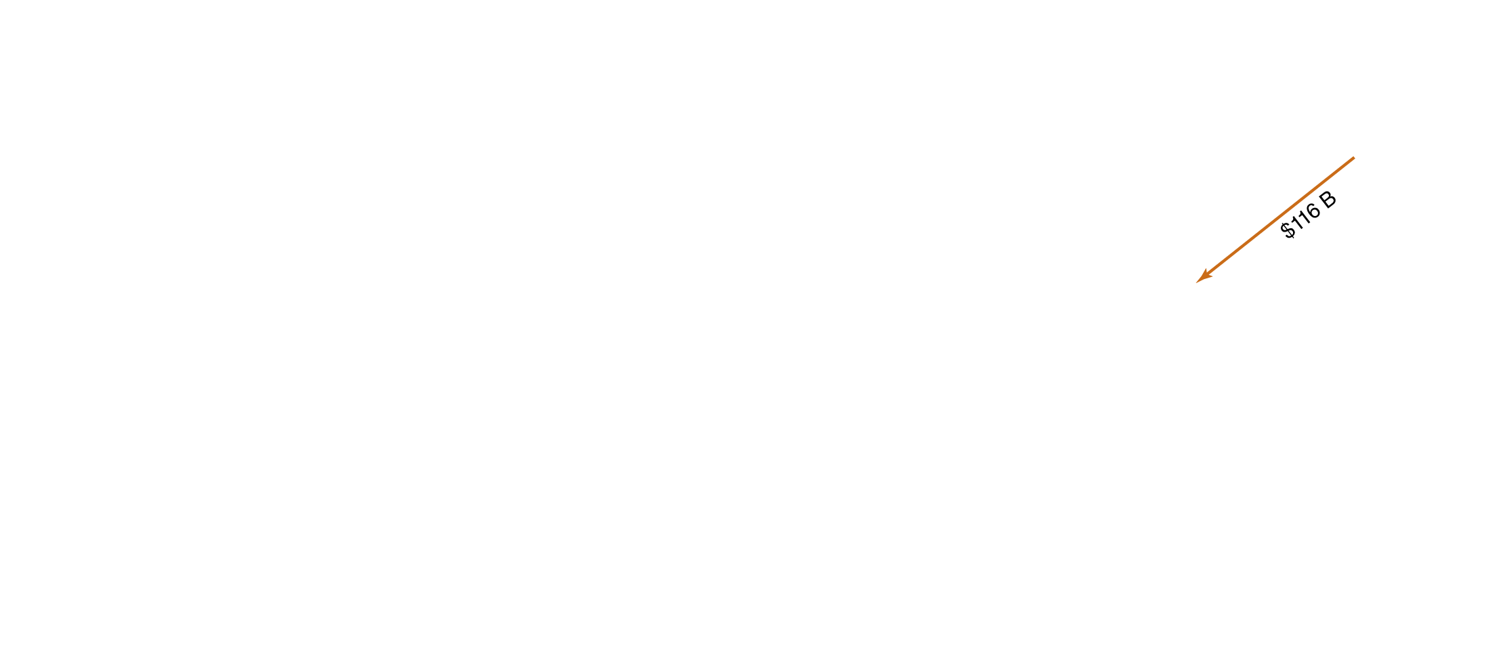
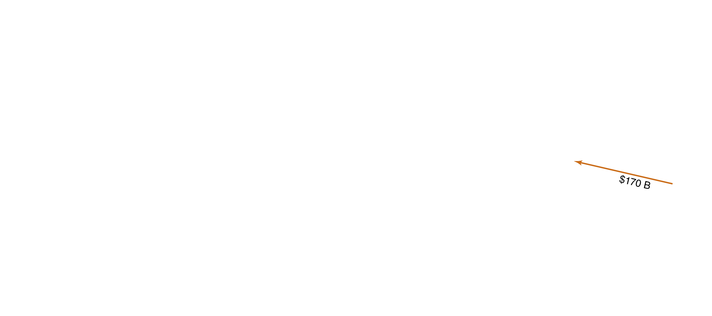

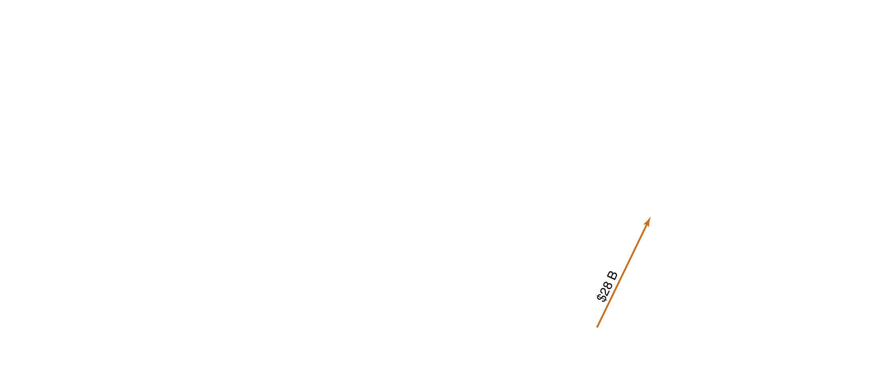

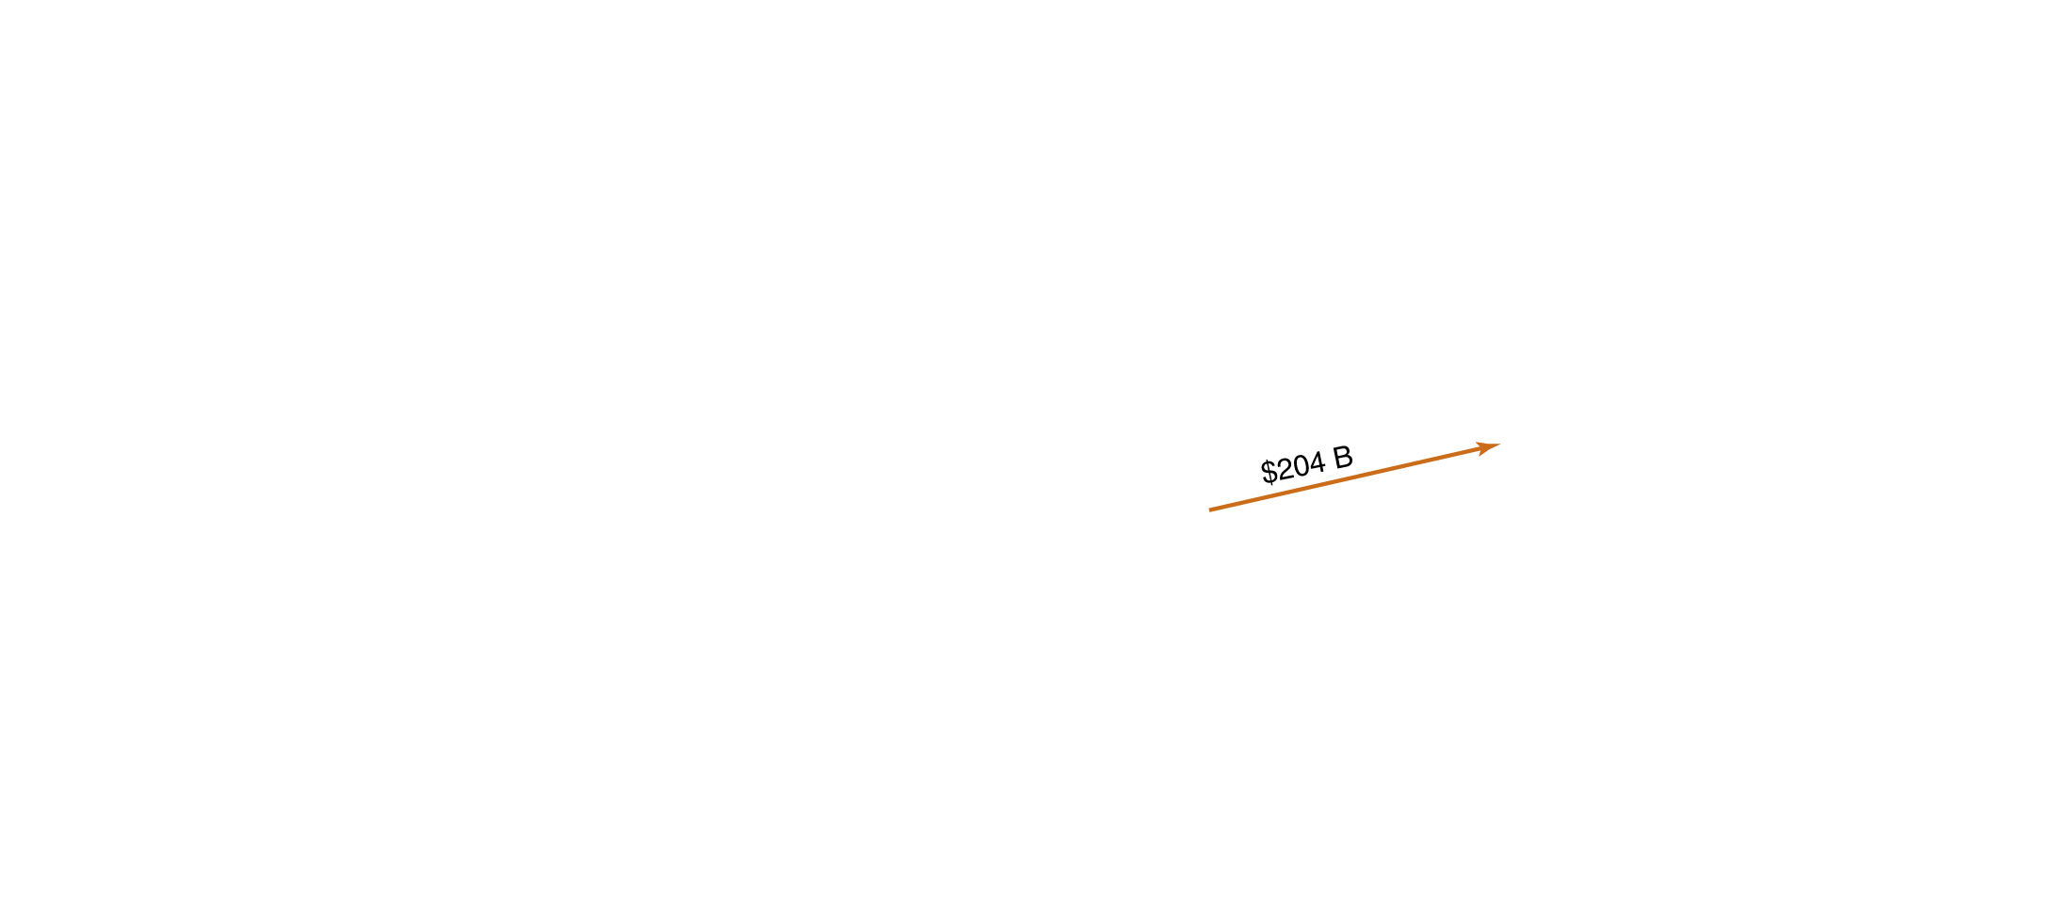
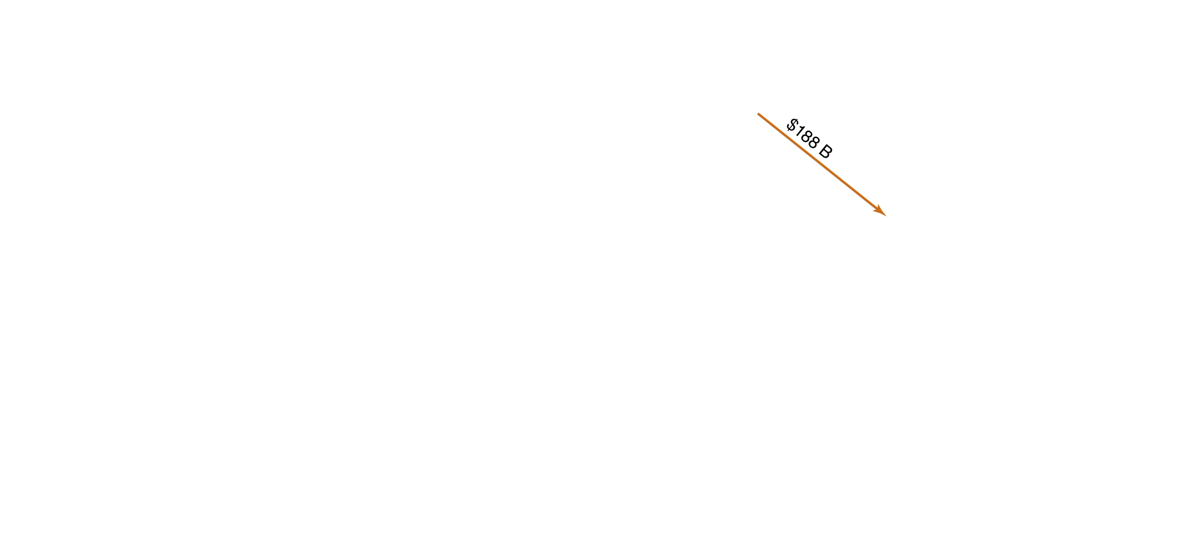


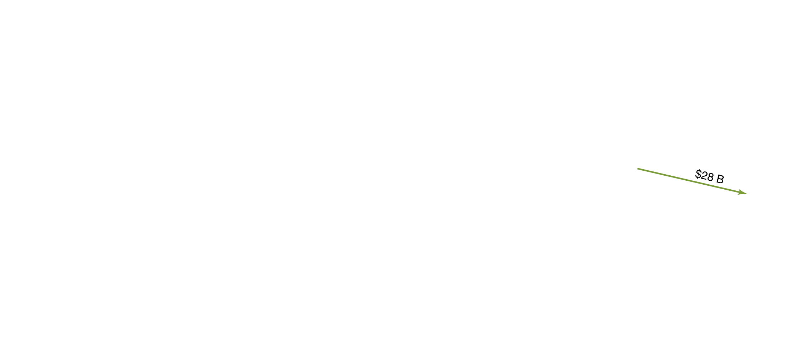
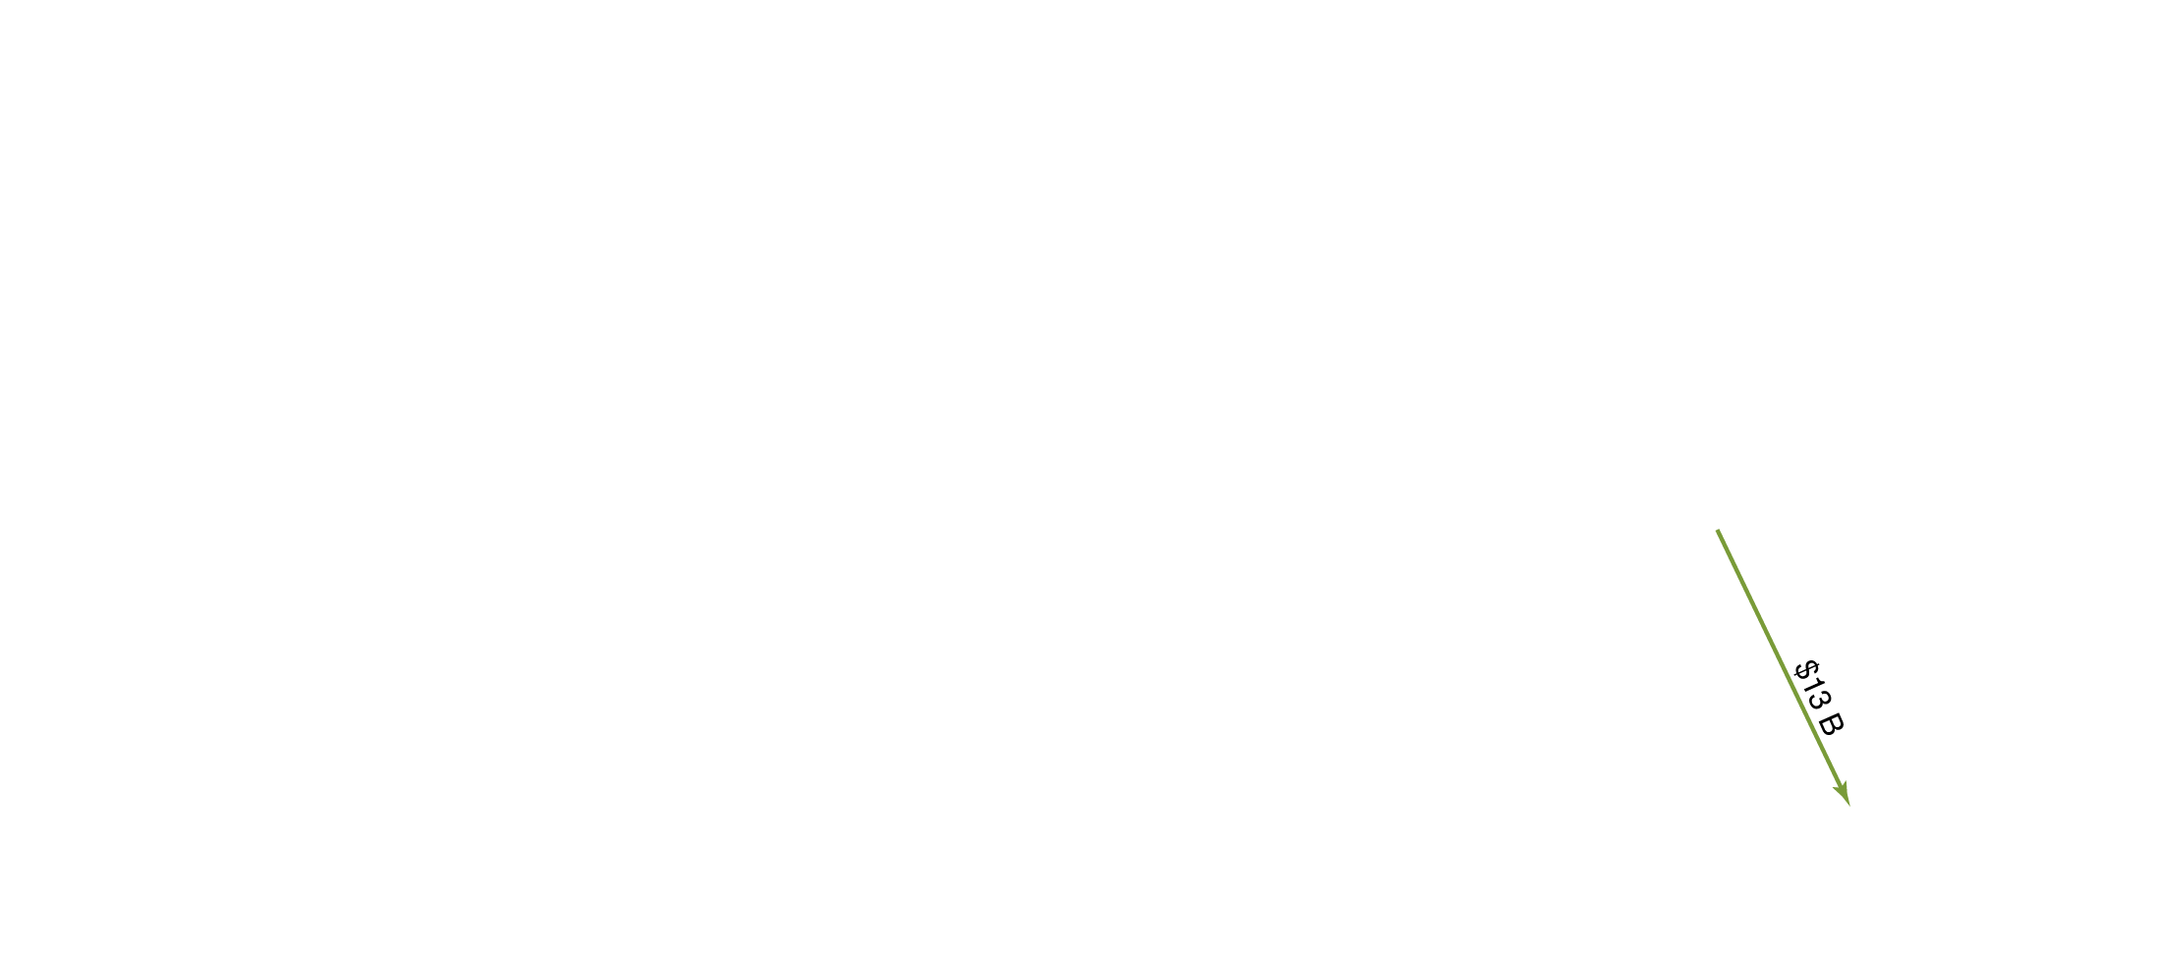
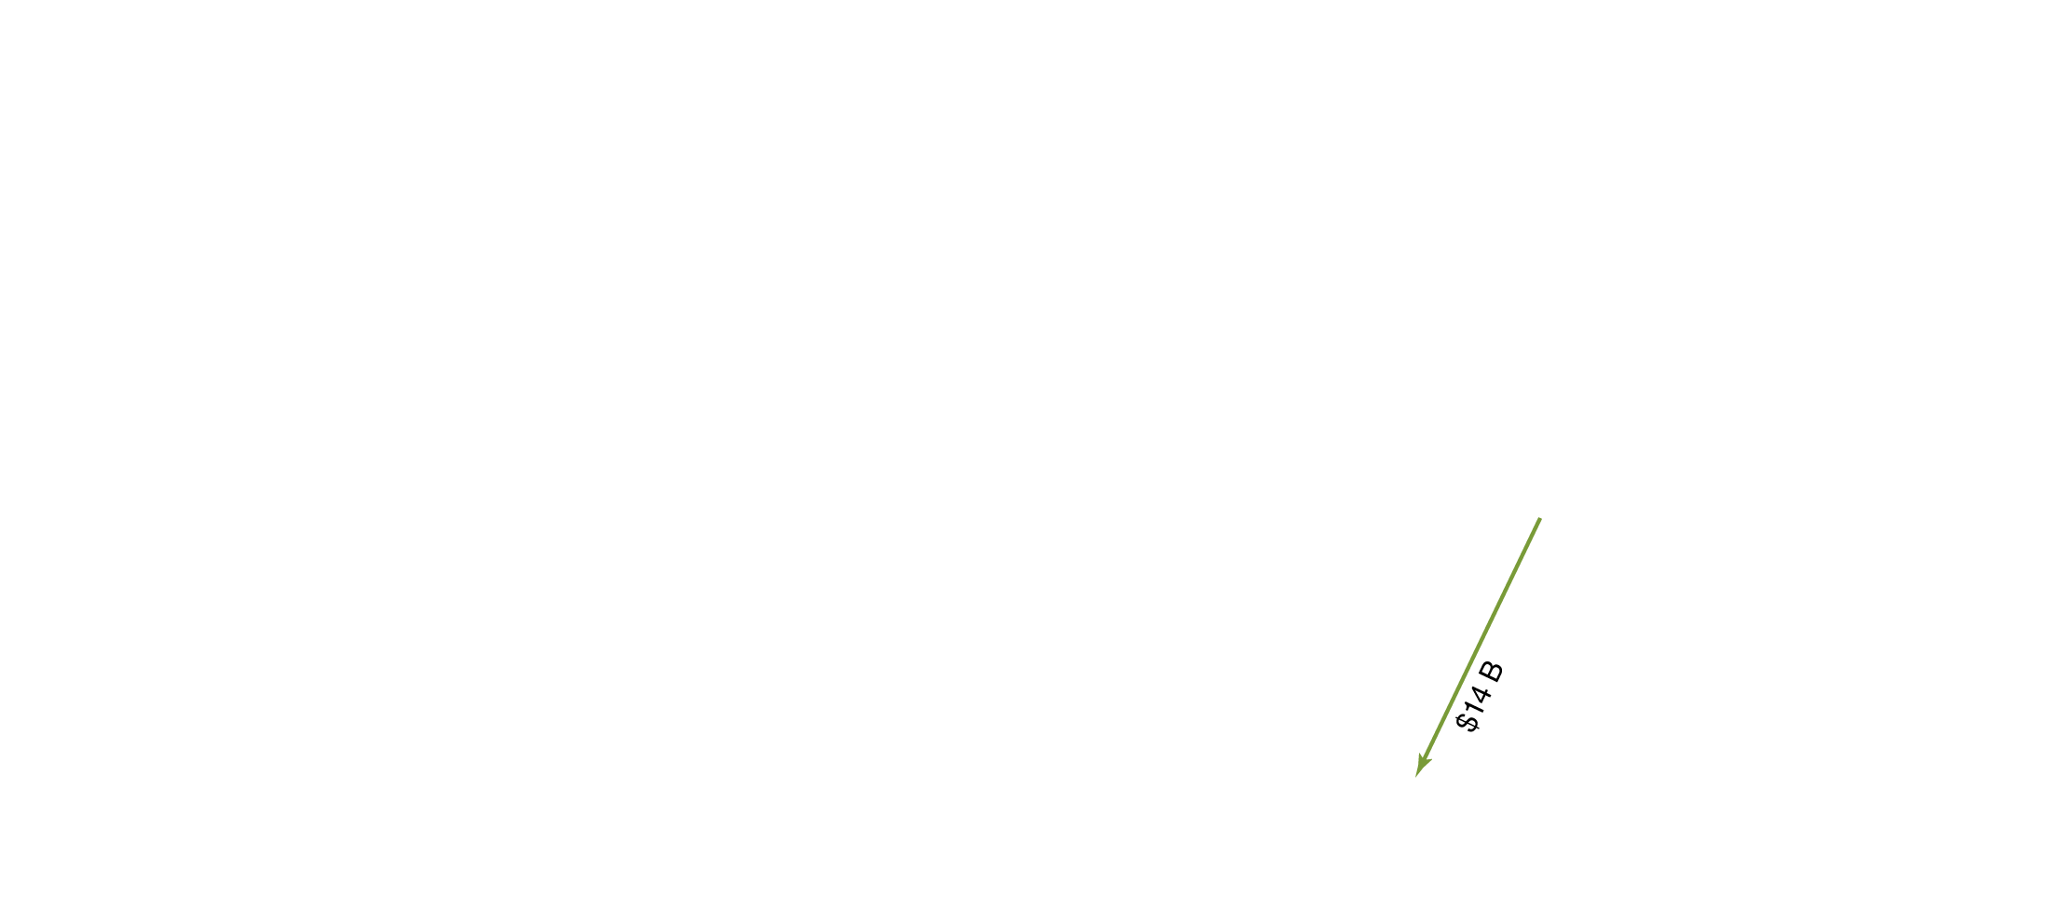

The current account and the balance of trade
Japan also ran a trade deficit in 2012, of $87 billion in 2012.
On the other hand, China (not shown) had a trade surplus of $231 billion in 2012.
You might notice that the trade figures between the U.S. and Japan on this slide are not the same as on the previous slide (they were $149 and $72 billion respectively).
This highlights the fact that trade figures are not measured exactly.
Figure 18.1b
Trade flows for the United States and Japan, 2012

Slide 11
The rest of the current account
The balance of services is the difference between the values of the exports and imports of services.
Net exports is the sum of the balance of trade and the balance of services.
The current account balance is the sum of net exports, net income on investments, and net transfers.
For simplicity, we will frequently ignore the latter two—their sum is close to zero for the U.S.—and think of net exports as being equal to the current account balance.

Slide 12
The financial account
While the current account records short-term flows of funds into and out of the country, the financial account records long-term flows:
Capital outflows: purchases of assets overseas by Americans
Capital inflows: purchases of American assets by foreigners
These assets might be financial assets, like stocks and bonds—foreign portfolio investment—or physical assets, like factories—foreign direct investment.
The balance on the financial account can be thought of as a measure of net capital flows; or alternatively as its negative, net foreign investment, which is the difference between capital outflows from a country and capital inflows.

Slide 13
The capital account
Prior to 1999, the financial account and the capital account were known collectively as “the capital account”.
Since then, the capital account refers only to relatively minor transactions, like migrants’ transfers, or sales and purchases of non-produced, nonfinancial assets like intellectual property or natural resource rights.
The balance on the capital account is relatively small—$7 billion in 2012—so we will ignore it.

Slide 14
The Foreign Exchange Market and Exchange Rates
29.2
Explain how exchange rates are determined and how changes in exchange rates affect the prices of imports and exports.

Slide 15
Foreign exchange rate
When a firm or consumer wants to buy something—a good, a service, a financial asset—from a foreigner, that foreigner will often want to be paid in their own currency.
The rate at which one country’s currency can be traded for another’s is known as the nominal exchange rate.
Example: If one U.S. dollar can purchase 100 Japanese yen, then the exchange rate is ¥100 = $1; or alternatively, ¥1 = $0.01.
Economists also calculate the real exchange rate, which corrects the nominal exchange rate for differences in prices of goods and services between countries.
Foreign exchange markets are very active; over $3 trillion in currency is traded in foreign exchange markets each day. Almost all of this in electronic form.

Slide 16

Exchange rate listings
Exchange Rate Between the Dollar and the Indicated Currency
Currency | Units of Foreign Currency per U.S. Dollar | U.S. Dollars per Unit of Foreign Currency
Canadian dollar | 1.03 | 0.97
Japanese yen | 96.23 | 0.01
Mexican peso | 12.62 | 0.08
British pound | 0.65 | 1.55
Euro | 0.75 | 1.33
The exchange rates in the table above are for August 9, 2013.
The two versions of the exchange rate are reciprocals of each other; 1.03 Canadian dollars bought 1 U.S. dollar, or equivalently 1 Canadian dollar bought 1/1.03 = 0.97 U.S. dollars.

Slide 17
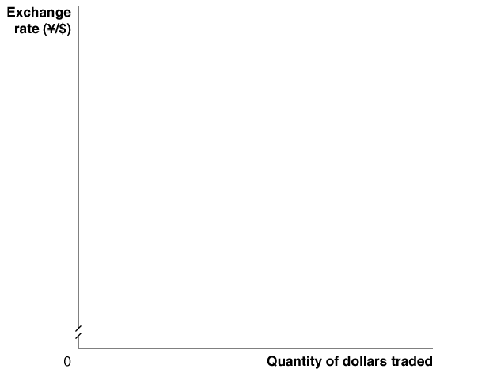
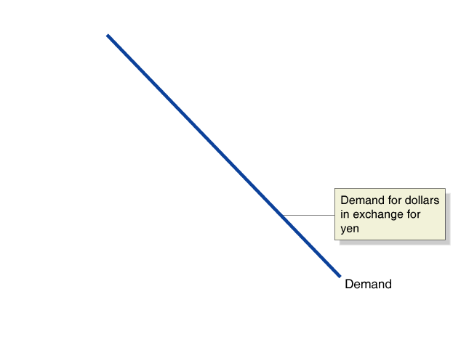
Demand for the U.S. dollar
Market exchange rates are determined by supply and demand, just like any price.
The demand for $US comes from:
Foreign firms and households wanting to buy U.S. goods and services
Foreign firms and households wanting to invest in U.S. physical or financial assets
Currency traders believing the value of the $US will rise
There is a demand for $US in each foreign currency—Japanese yen, for example.
Figure 18.2
Equilibrium in the foreign exchange market
Notes:
When the exchange rate is ¥150 to the dollar,
it is above its equilibrium level, and
there will be a surplus of dollars. When the
exchange rate is ¥100 to the dollar, it is below
its equilibrium level, and there will be
a shortage of dollars. At an exchange rate
of ¥120 to the dollar, the foreign exchange
market is in equilibrium.

Slide 18
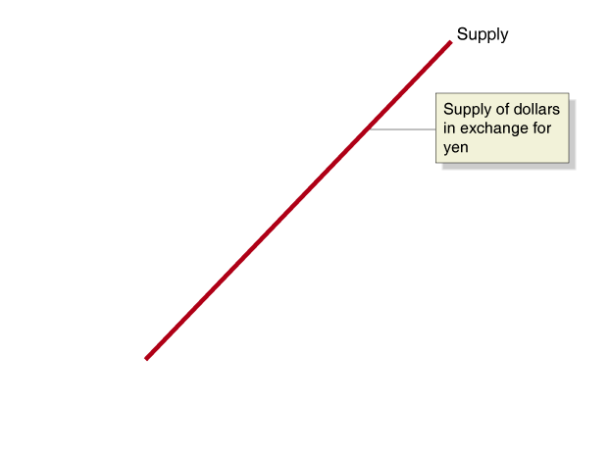
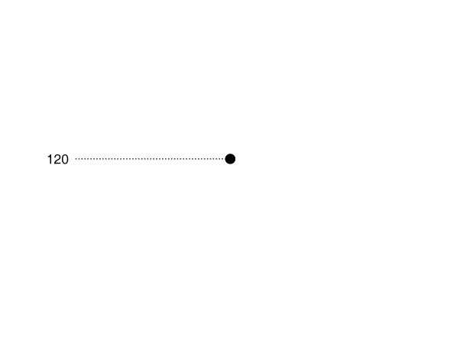
Equilibrium in the foreign exchange market
Unlike in markets for goods and services, the supply of $US is caused by just the same elements as cause the demand for $US, only in reverse: firms, households, and speculators wanting to obtain (say) Japanese yen, and pay for them with U.S. dollars.
The equilibrium exchange rate is the exchange rate at which the quantity of dollars supplied is just equal to the quantity of dollars demanded.
Figure 18.2
Equilibrium in the foreign exchange market

Slide 19
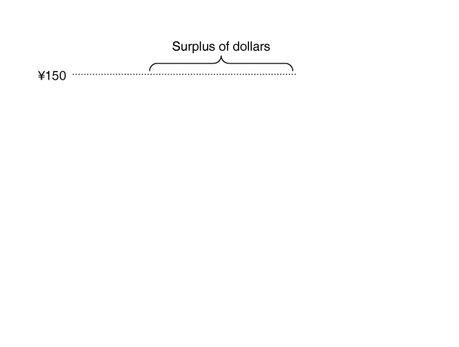
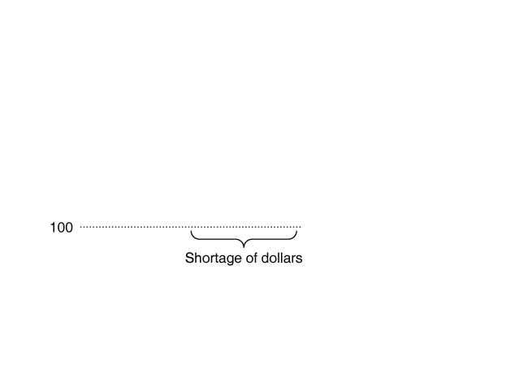
Currency appreciation and depreciation
If the exchange rate is “too high”, more people will want to sell $US for yen than want to buy them—a surplus.
The exchange rate will depreciate: the value of the $US will fall, relative to the value of the yen.
If the exchange rate is too low, there will be a shortage of $US.
Then the exchange rate will appreciate: the value of the $US will rise, relative to the value of the yen (or any other given currency).
Figure 18.2
Equilibrium in the foreign exchange market

Slide 20
Are all exchange rates market-determined?
We assume in this chapter that exchange rates are determined by the market.
But this is not always true.
Example: For more than 10 years, the value of the Chinese yuan was fixed by the Chinese government at 8.28 yuan = $1.
Fixed exchange rates have important consequences; we will consider them in the next chapter.

Slide 21
Changes in the demand and supply for foreign exchange
Anything (apart from the exchange rate itself) affecting the demand for foreign exchange will shift the demand curve—to the right for an increase in demand, to the left for a decrease.
This might result from:
Changes in the demand for U.S.-produced goods and services, relative to foreign produced goods and services
Changes in the desire to invest in the U.S. relative to foreign countries
Changes in the expectations of currency traders about the likely future value of $US relative to foreign currencies
The supply of $US for yen is the same as the demand for yen with $US; so the same factors that change demand also change supply.

Slide 22
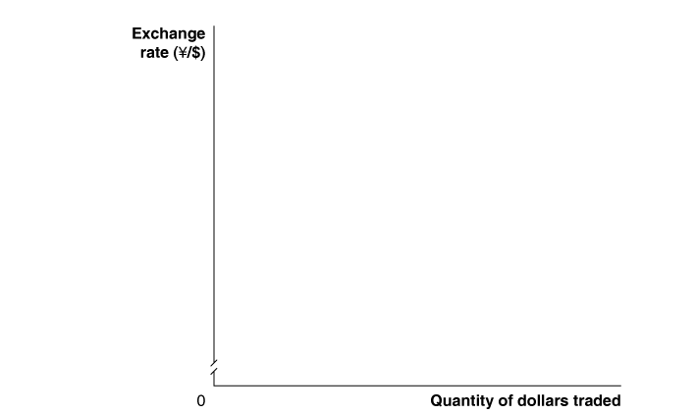
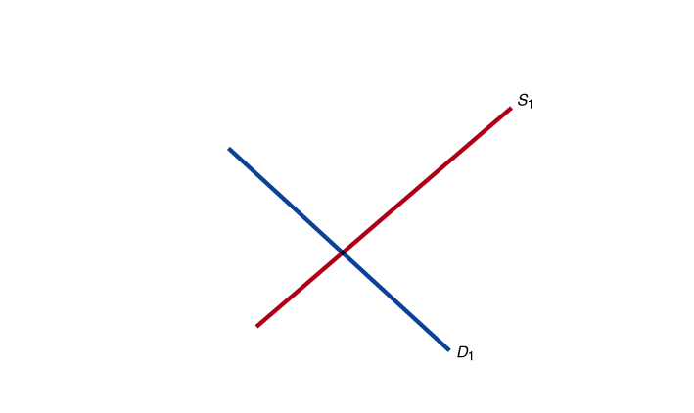
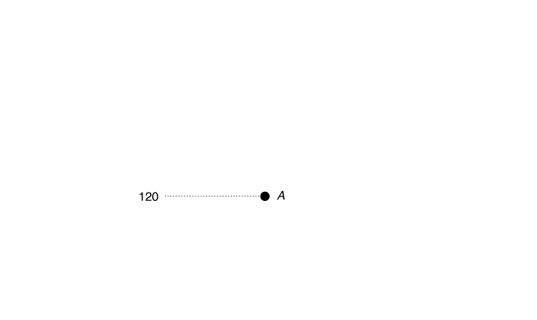
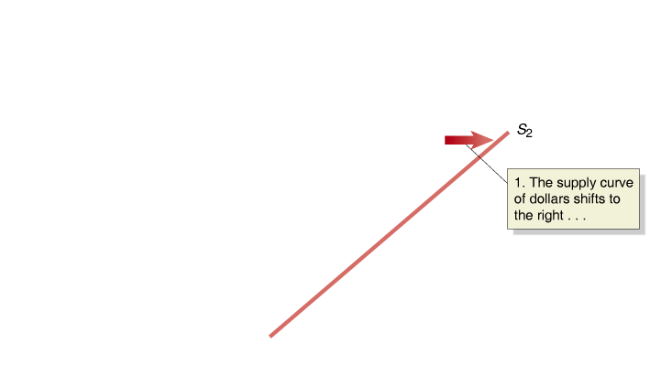
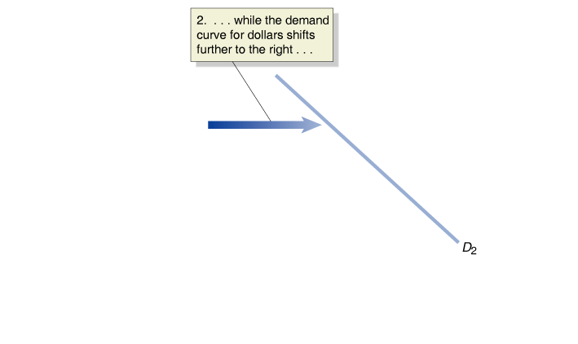
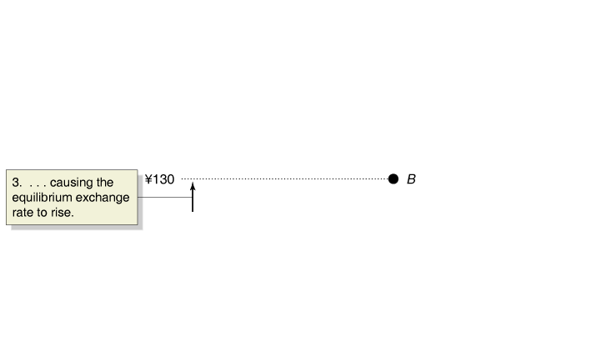
Adjustment to a new foreign exchange market equilibrium
Suppose the exchange rate of yen for $US starts out at ¥120 = $1.
U.S. incomes rise, increasing our demand for Japanese imports. To pay for the imports, we need to buy yen, hence we supply $US to the foreign exchange market.
At the same time, interest rates
in the U.S. rise, making U.S.
bonds more attractive to hold
than Japanese bonds. So the demand for $US rises.
If the increase in demand is larger than the increase in supply of $US, the exchange rate will appreciate—to ¥130 = $1, in this case.
Figure 18.3
Shifts in the demand and supply curve resulting in a higher exchange rate
Notes:
Holding other factors constant, an increase in
the supply of dollars will decrease the equilibrium
exchange rate. An increase in the
demand for dollars will increase the equilibrium
exchange rate. In the case shown
in this figure, both the demand curve and
the supply curve have shifted to the right.
Because the demand curve has shifted to
the right by more than the supply curve,
the equilibrium exchange rate has increased
from ¥120 to $1 at point A to ¥130 to $1 at
point B.

Slide 23
Currency speculation
A large amount of trade in foreign exchange is by speculators, currency traders who buy and sell foreign exchange in an attempt to profit from changes in exchange rates.
Speculators purchase and hold a currency when the believe it will appreciate; or they may engage in more complicated financial transactions, for example to buy currency in the future at a price agreed today.

Slide 24
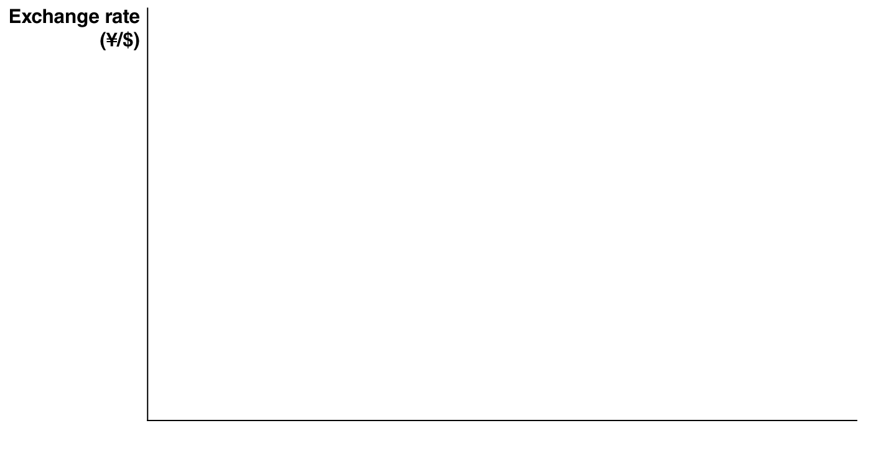
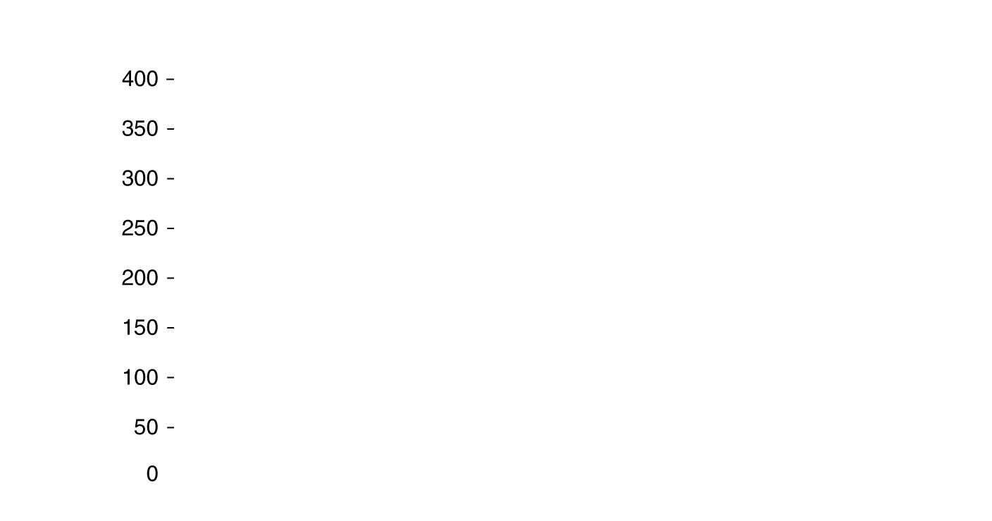
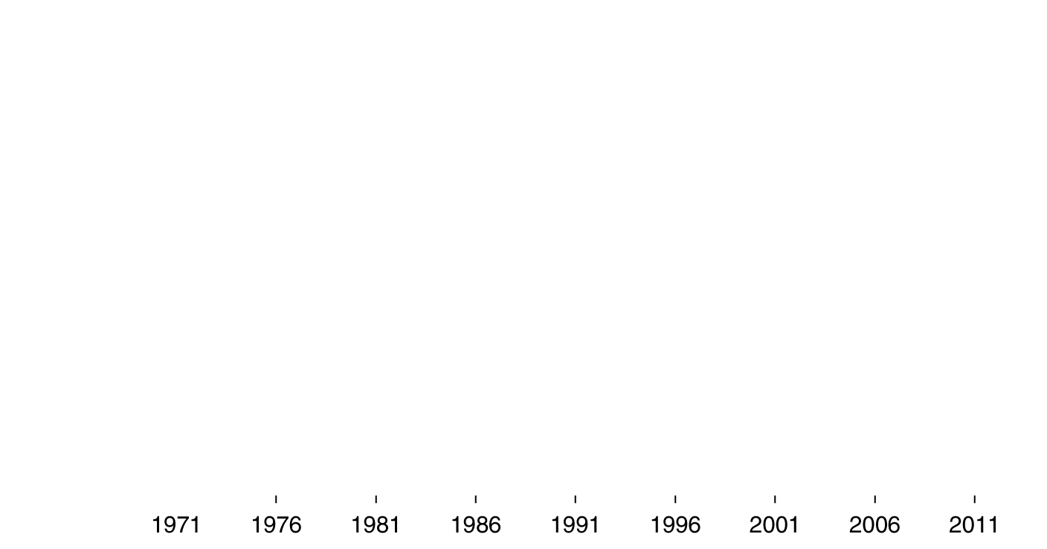






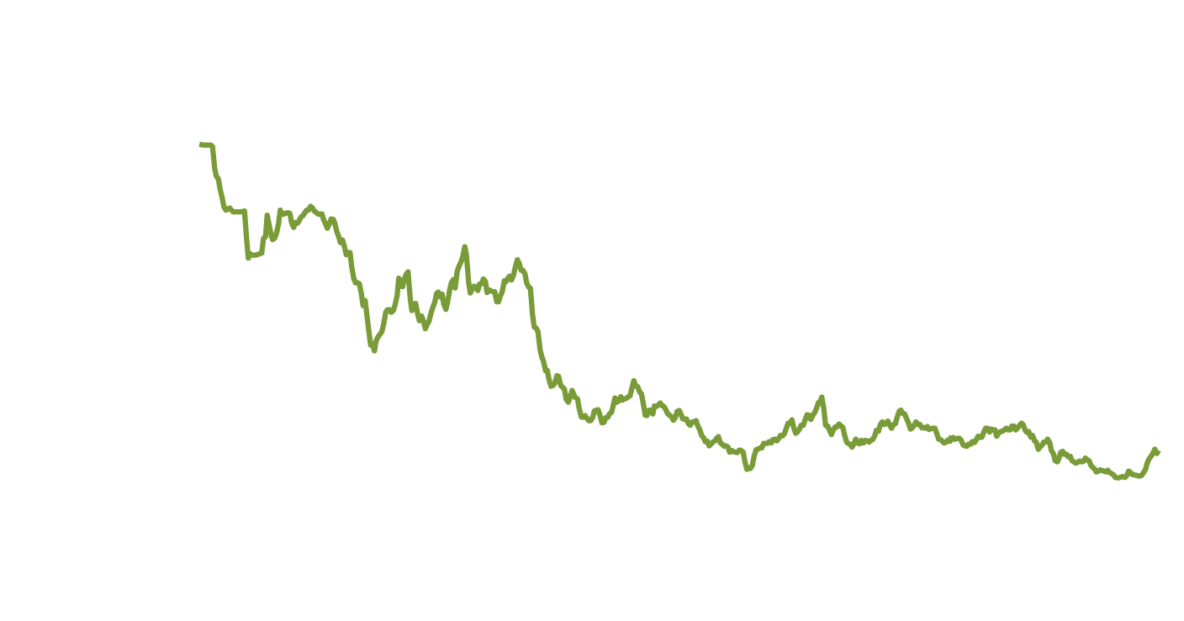
Japanese firms ride the yen roller coaster
Because many large Japanese firms rely heavily on sales in the United States and other foreign countries, their profits are highly dependent upon the yen exchange rates.
When the yen appreciates, as it has done overall for the last 40 years, Japanese exports become more expensive to foreigners, so Japanese exporters make less profit.
However the rate has not changed consistently; this creates exchange rate risk for firms doing business internationally.
Notes:
Red bars show U.S. recessions.
Not made explicit in 5th edition, first printing: exchange rate falls (yen appreciates) after recessions. Likely due to easy money from Fed.

Slide 25
Exchange rates, imports, and exports
When the $US appreciates, the dollar price of foreign imports falls. Similarly, the foreign currency price of U.S. exports rises.
Example: Suppose the exchange rate between $US and euros is $1 = €1. An iPhone with a U.S. price of $200 will cost €200 to a French person. But if the $US appreciates, so the exchange rate is now $1 = €1.20, that same iPhone will now cost the French person €240.
Then we expect French people to buy fewer iPhones. But at the same time, French wine has become cheaper for Americans to buy, so we will buy more of it.
An appreciation of the $US causes U.S. exports to fall and imports to rise; so net exports will fall.
Hence aggregate demand will fall, and also real GDP.

Slide 26
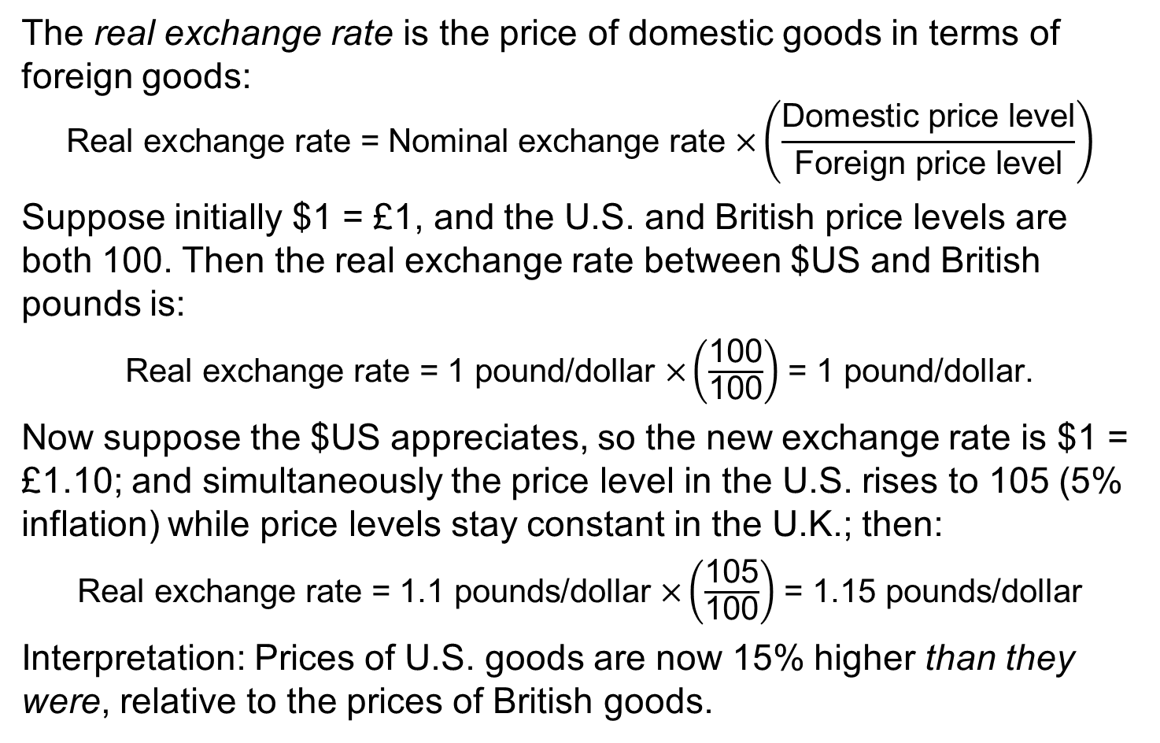
Real exchange rates
The real exchange rate is the price of domestic goods in terms of foreign goods:
$$\text{Real} \text{exchange} \text{rate}\text{ = }\text{Nominal} \text{exchange} \text{rate} \text{×}\left(\frac{\text{Domestic} \text{price} \text{level}}{\text{Foreign} \text{price} \text{level}}\right)$$
Suppose initially $1 = £1, and the U.S. and British price levels are both 100. Then the real exchange rate between $US and British pounds is:
$\text{Real} \text{exchange} \text{rate}\text{ = 1 }\text{pound}\text{/}\text{dollar} \text{×}\left(\frac{\text{100}}{\text{100}}\right)$ = 1 pound/dollar.
Now suppose the $US appreciates, so the new exchange rate is $1 = £1.10; and simultaneously the price level in the U.S. rises to 105 (5% inflation) while price levels stay constant in the U.K.; then:
$\text{Real} \text{exchange} \text{rate}\text{ = 1.1 }\text{pounds}\text{/}\text{dollar} \text{×}\left(\frac{\text{105}}{\text{100}}\right)$ = 1.15 pounds/dollar
Interpretation: Prices of U.S. goods are now 15% higher than they were, relative to the prices of British goods.

Slide 27
The International Sector and National Saving and Investment
29.3
Explain the saving and investment equation.

Slide 28
Net exports equal net foreign investment
When a country’s spending exceeds its income, it finances the difference by selling assets or by borrowing. So
Current account balance + Financial account balance = 0
Therefore:
Current account balance = – Financial account balance
That is,
Net exports = Net foreign investment
When U.S. net exports are negative, U.S. net foreign investment is negative by the same amount.
Similarly, China exports more than it imports; so each year, their net foreign investments must be positive, and of the same amount.

Slide 29
Domestic saving/investment and net foreign investment
Saving in an economy can be expressed as:
National saving = Private saving + Public saving
S = S_{private} + S_{public}
where: Private saving = Disposable income – Consumption
S_{private} = (Y – T) – C
and: Public saving = Taxes – Government spending
S_{public} = T – G
so: S = (Y – T) – C + T – G
but: Y = C + I + G + NX
so: S = (C + I + G + NX – T) – C + T – G
S = I + NX
Then by the previous slide’s identity,
National saving = Investment + Net foreign investment

Slide 30
Savings and investment equation
National saving = Investment + Net foreign investment
This is known as the savings and investment equation, showing that national saving is equal to domestic investment plus net foreign investment.
Example: If you save $1,000 and use it to buy a bond issued by General Motors, GM might use the $1,000 to help build a domestic factory (I), or build a factory in China (NFI).
A useful way to rewrite this identity is as:
S – I = NFI
This highlights the fact that if net foreign investment (i.e. net exports) is negative, then domestic savings must be less than domestic investment.

Slide 31
The Effect of a Government Budget Deficit on Investment
29.4
Explain the effect of a government budget deficit on investment in an open economy.

Slide 32
Budget deficits and the saving and investment equation
When the government runs a budget deficit, S_{public} is negative, and national savings tends to decline.
By the saving and investment equation, we know domestic investment and/or net foreign investment must decline.
Why? When the government runs a budget deficit, it finances its dissaving by selling bonds. To attract buyers, the government must typically raise interest rates.
  Higher interest rates discourage firms from making investments.
  They encourage funds to flow to the U.S. to buy those bonds, causing the $US to appreciate; but this causes net exports to fall. And net exports equal net foreign investment.

Slide 33
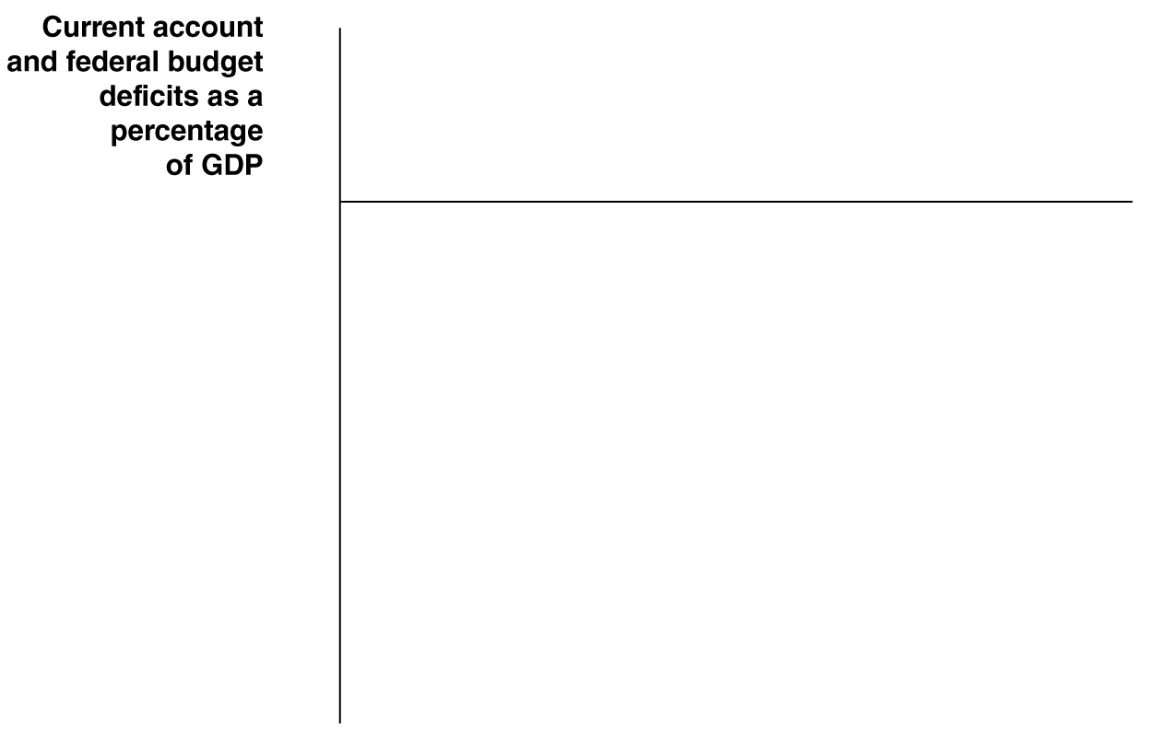
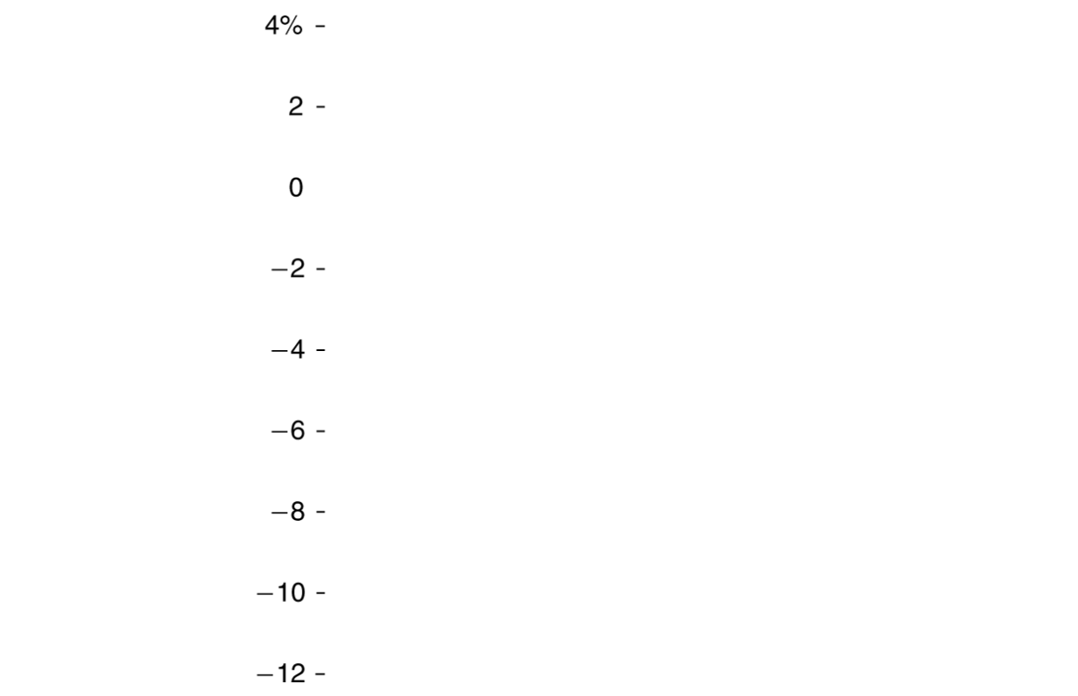
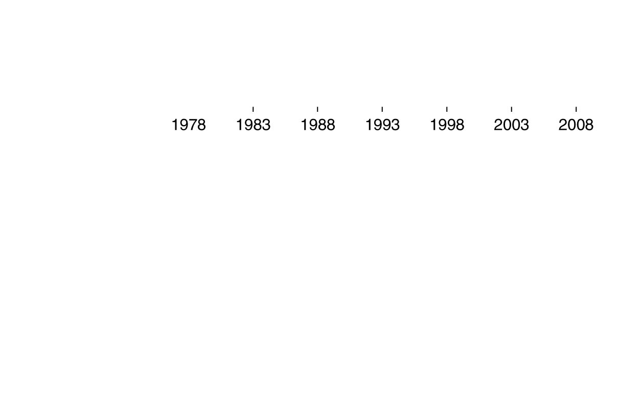
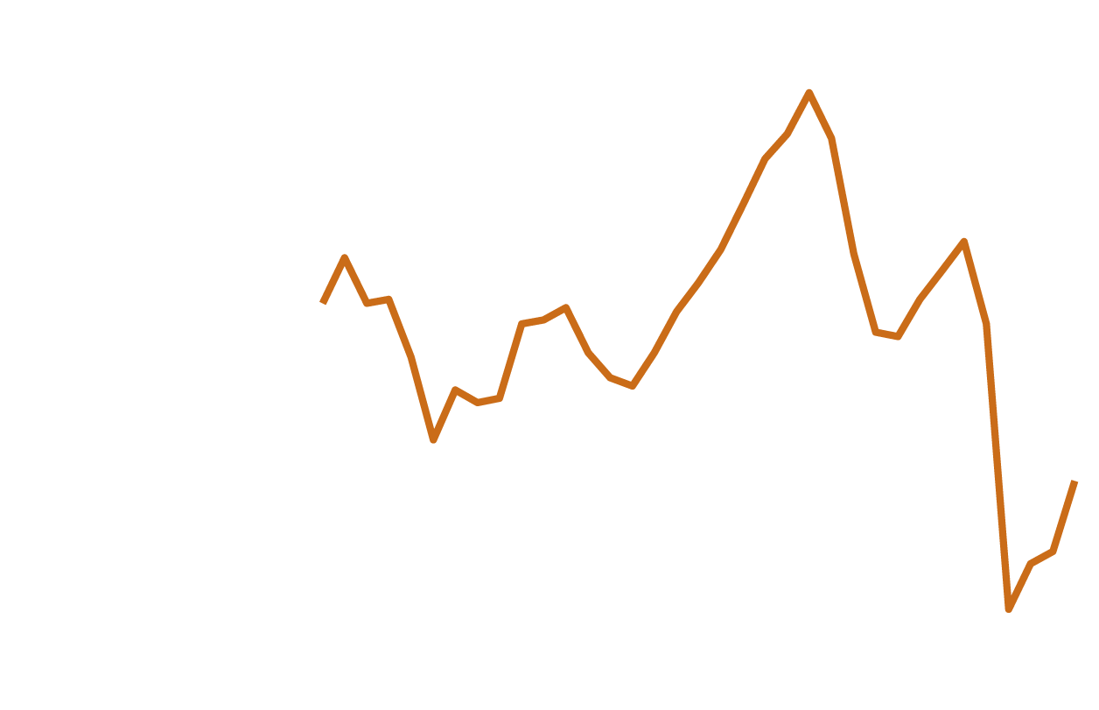
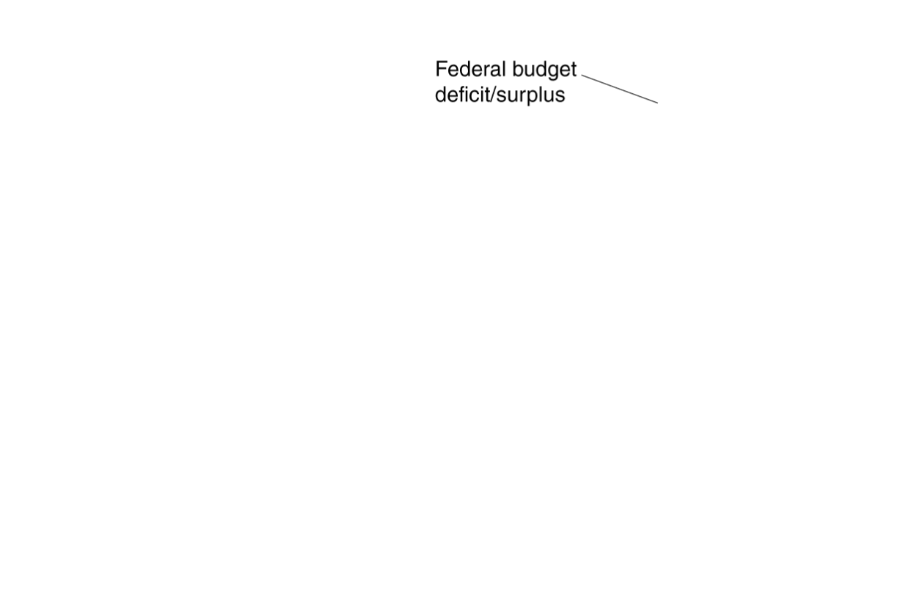
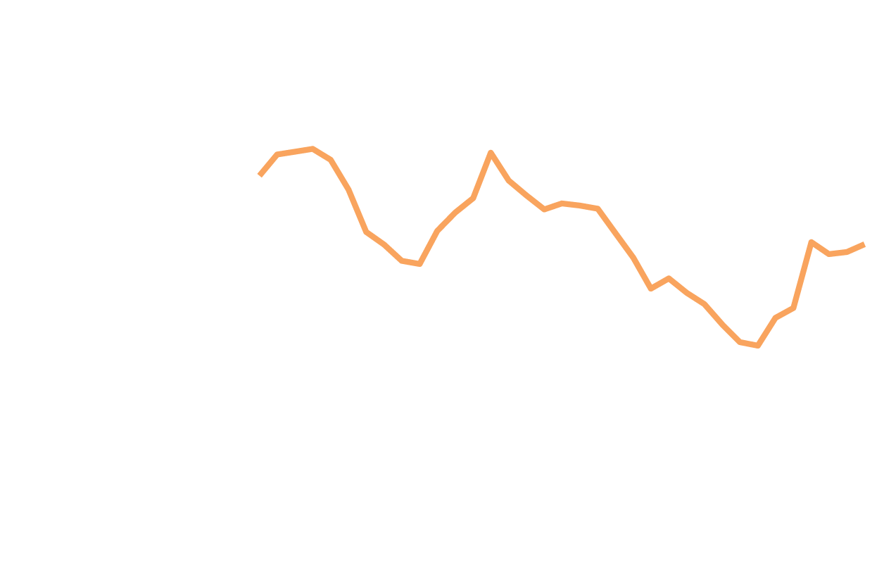
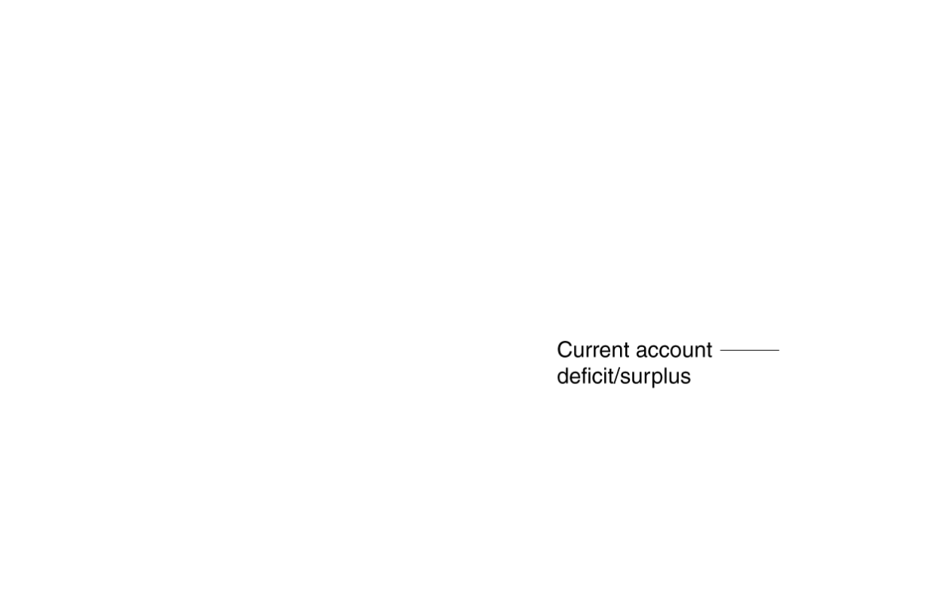
The twin deficits, 1978-2012
When government budget deficits lead to declines in net exports, the situation is known as twin deficits.
This was a big concern in the early 1980s: large federal budget deficits resulted in high interest rates; high $US exchange rates and large current account deficits followed.
But since 1990, the budget deficit and current account deficit do not seem to be strongly related; and evidence from other countries is mixed.
Figure 18.4
The twin deficits, 1978-2012
Notes:
During the early 1980s, large federal budget
deficits occurred at the same time as large
current account deficits, but twin deficits
did not occur in most other periods during
these years.
Source: U.S. Bureau of Economic Analysis.

Slide 34




The United States: the “World’s Largest Debtor”
The graph shows the current account balance in the U.S. from 1960-2012.
By the end of 2012, foreign investors owned about $3.9 trillion more of U.S. assets—stocks, bonds, factories, etc.—than U.S. investors owned of foreign assets.
This seems alarming; but
(1) it is a vote of confidence in the U.S. economy, and
(2) the funds have been critical in financing investment and hence growth in the U.S. despite low personal savings rates.

Slide 35
Monetary Policy and Fiscal Policy in an Open Economy
29.5
Compare the effectiveness of monetary policy and fiscal policy in an open economy and in a closed economy.

Slide 36
Monetary policy in an open economy
Is monetary policy more effective in an open economy or in a closed economy?
Expansionary monetary policy effectively means lowering interest rates.
In a closed economy, this encourages investment, and consumption spending on durables.
In an open economy, the demand for $US falls, decreasing the exchange rate; but this causes net exports to rise.
Therefore through this additional policy channel, the expansionary monetary policy will increase aggregate demand by more in an open economy than in a closed economy.
Of course, the same is true of contractionary monetary policy. Monetary policy is more effective in an open economy.

Slide 37
Fiscal policy in an open economy
Is the same true of fiscal policy: is it also more effective in an open economy?
To find out, we can explore the effect of expansionary fiscal policy on the additional policy channel, net exports:
Tax cuts or increased government spending increase aggregate demand
But this might result in higher interest rates, crowding out net exports due to the appreciating $US
Also, the multiplier effect is lower, since some spending takes place on imported goods, which do not feed back in to real GDP.
Hence expansionary fiscal policy will be less effective in an open economy than in a closed economy.
(Naturally, the same will be true of contractionary fiscal policy: all fiscal policy is less effective in an open economy.)

Slide 38
Common misconceptions to avoid
There is a lot of new terminology here, and many of the phrases, like balance of trade, balance of services, and current account balance sound very similar. Be careful not to confuse them.
When the $US appreciates, the price of the $US in terms of other currencies goes up. Simultaneously, the price of other currencies in terms of the $US goes down. Depreciation is the opposite.

